Slide 1
Workforce Pell
OASFAA Conference 2026

Slide 2
Outline
How Did We Get Here?
What Does the Law Actually Say
NegReg Process
ED alignment with DoL
What Comes Next?
Implications for states
Implications for schools

Slide 3
How did we get here: History
Existing law for ‘Short Term Programs’ : DL only
A decade of Congressional bottleneck
Institutional and Program Quality Concerns
Online Programs
For-profit
Pay For
Coding Boot Camps
A decade of Congressional intent

Slide 4
How Did We Get Here: OB3
Shift from Short-Term Pell to “Workforce Pell”
Does not appear to merge WFP to Short-term programs
Creates a second distinct program eligibility type
The problem with people still saying “Short-Term Pell”
Many points of consistency with prior legislative bills
Completion/placement, time/credit framework
Some new details / twists
Name (again), economic metrics, increased role for state
All accredited institutions can potentially participate
Online programs yes
Correspondence coursework no
Study abroad no
Remedial English no

Slide 5
What Does the Law Actually Say
Sec. 83002: https://www.congress.gov/bill/119th-congress/house-bill/1/text
Effective Date: July 1, 2026 (technically)
Student Eligibility
Enrolled in an eligible WFP program
May have a bachelors
May not be enrolled in or have a graduate credential*
Students may receive less than minimum Pell due to proration
No simultaneous double dip
WFP Pell counts towards 600% LEU

Slide 6
What Does the Law Actually Say: Programs
At least 150 clock hours (or credit equivalent)
Less than 600 clock hours (or credit equivalent)
“Minimum of 8 but less than 15 weeks”
“High-skill High-Wage”
Leads to either:
Terminal credential in employment field
“Stackable and portable”
70% Completion rate
70% Job placement rate, 180 days out

Slide 7
What Does the Law Actually Say
Verbatim: “the program has been offered by the eligible institution for not less than 1 year prior to the date on which the Secretary makes a determination under this clause”
We’ll return to this
Economic requirements:
Tuition & Fees < “Value-added earnings”
Calculation of what VAE means
Salary Modified by Location
Modified Earnings > 150% of poverty rate ($21.9k)
If T&F is $10k, then salary must > $31.9k to pass

Slide 8
Negotiated Rulemaking: What is it?
It’s it
OPE & FSA
Stages
Declaration of intent (fall 2025)
Initial Public Comment period
In-person Discussion (Dec 2025)
Draft rules (soon?)
Public comment period – expected to be 30 days
ED required to respond to all comments
Final rules
Normally by Nov 1 to comply with federal calendar
In this case likely before July 1
Downstream Timeline?

Slide 9
Negotiated Rulemaking
Alignment of Labor and ED
WIOA: Workforce Innovation & Opportunity Act (2014)
https://www.ed.gov/about/news/press-release/us-department-of-education-and-us-department-of-labor-take-next-steps-implement-postsecondary-education-partnership
Requires ED Approval
No self-certification
Can mix WFP & PEP
Must meet requirements / certification of both, however
As in the law, no double-dip
Student must ‘choose’
Subject to SAP & R2T4 (not surprisingly?)

Slide 10
Negotiated Rulemaking
Equivalent credits
Statute: 150 clock hours to ‘less than 600’
Proposal discussed relatively nice and clean:
6 to “less than 24” quarter credits
4 to “less than 16” semester credits
What does ‘less than’ mean in practice?
Must have two payment periods
This would be true anyway for clock hour
Weeks do not have to be consecutive
May be a mess for FA offices depending on structure
Good for Apprenticeship, etc.

Slide 11
Negotiated Rulemaking
No Grandfathering if Governor determines program ineligible
Beyond current payment period
Governor must provide certification of all programs for PPA renewal
Ineligible entity cap: 25%
Vs. standard program w/ 50% cap and 25% reporting threshold
‘12 months from governor approval’
Major shift from statutory language
Barrier in the short run; better in the long run?
Programs are Pell-only
For TIV
OOG eligibility

Slide 12
Break for questions on Statute/Regs
Things I missed?
Questions on things I said?
Different interpretations?
As an FAA, let Value Added Earnings be someone else’s problem
State / Provost / whoever

Slide 13
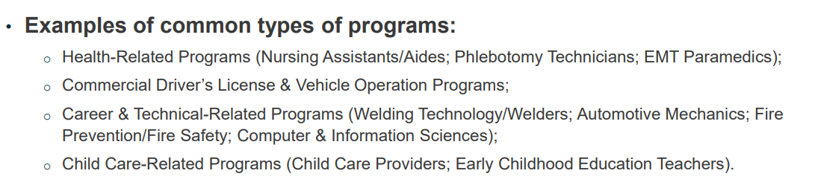
Where the Rubber Eats Road: Programs
ED Published List 12/2025:
Some dunkers
Welding, CIS
Some Missing?
Electrician, HVAC
Some curiosities:
Time: Phlebotomy on one end, Auto on the other
Earnings: Childcare
The dichotomy of health programs in general

Slide 14
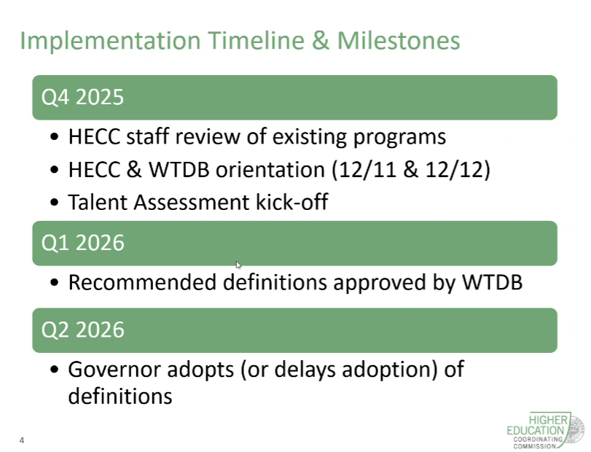
What’s Next: State & School Conversations
Zero chance any programs are funded 7/1/26
HECC
Timeline:
What’s not here
Authority given to Governor - what happens when administrations change?
What does that uncertainty mean for schools/students?

Slide 15
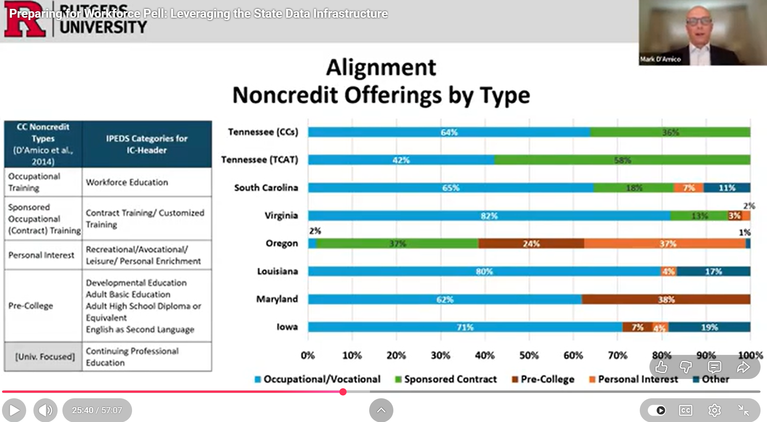
What’s Next: State & School Conversations
https://www.youtube.com/watch?v=7kwJjNf27wo
Pressure around non-credit (aka Clock-hour in TIV terminology)
OR skews heavily towards using non-credit for pre-college and personal interest
Economics aside, it’s just not clear (to me) the non-credit space as is fits with WFP intent & design

Slide 16
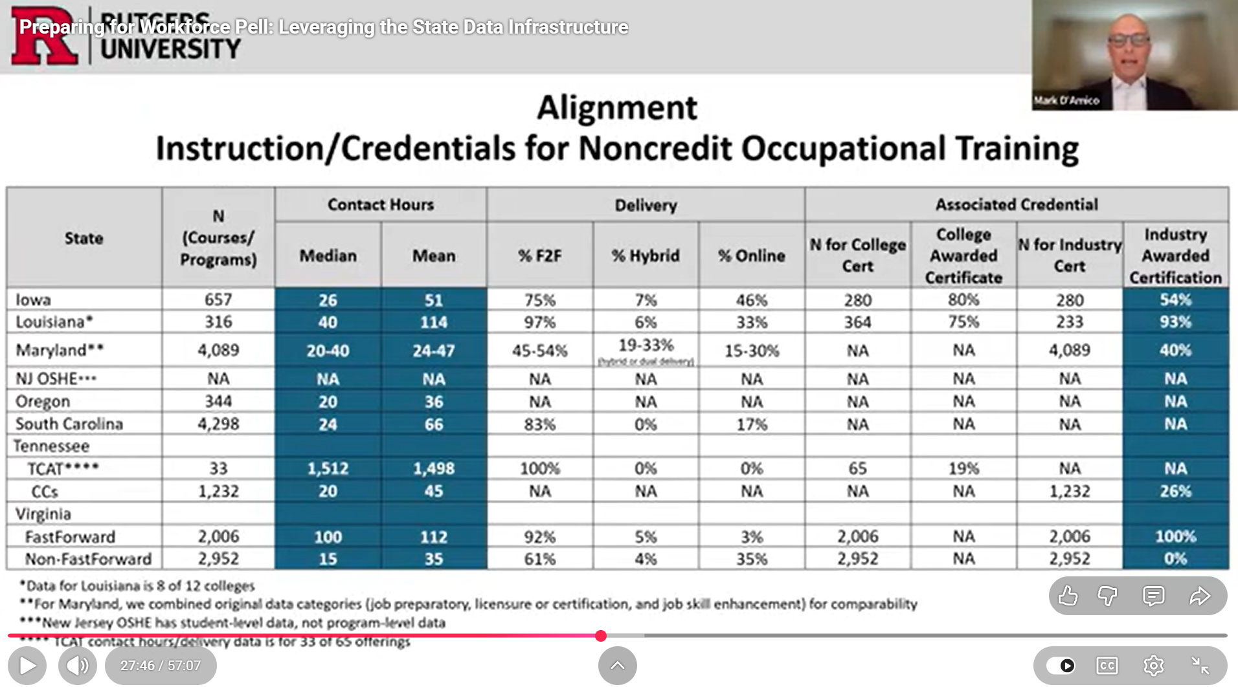
What’s Next: State & School Conversations
https://www.youtube.com/watch?v=7kwJjNf27wo
Generally speaking:
Contact Hrs >= Clock Hours
Contact Hours for Oregon non-credit programs:
Mean = 36
Median = 20
There may exception but available data suggests OR’s current suite of non-credit programs is generally too short to qualify under WFP and also not workforce-aligned

Slide 17
What’s Next: State & School Conversations
School conversations will vary
The national conversation
The actual economics
The appeal
The bad
For credit programs
When does it make sense/not to run as standalone WFP vs. embedded?
Implications of Pell-only
For non-credit/clock hour
Admin. Capability to deliver TIV for clock hour

Slide 18
Where does this leave us?
Practical Challenge:
What is the functional ceiling on program intensity?
How viable to complete 23.5 / 599 clock hours in X scheduled weeks?
599 hours / 10 weeks = 59.9 hours/wk
599 hours / 12 weeks = 49.9 hours/wk
599 hours / 14 weeks = 42.8 hours/wk
Credit version varies a bit depending on clock/credit conversion but roughly:
23 credits / 12 weeks = 57.5 hours/wk
Bigger question: how viable for 70% of students to complete on time?

Slide 19
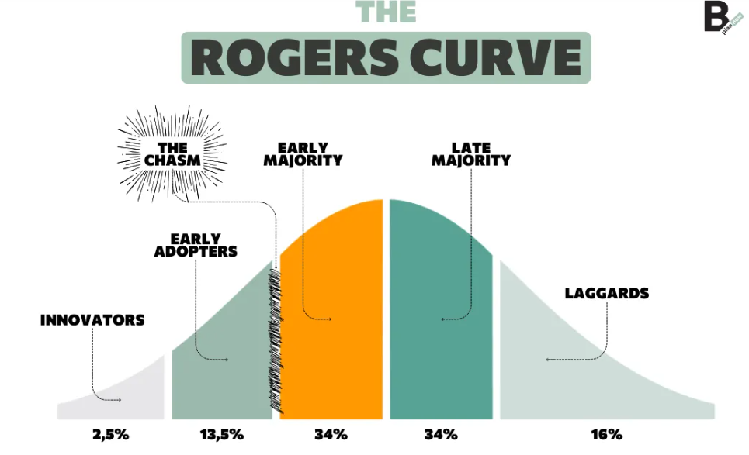
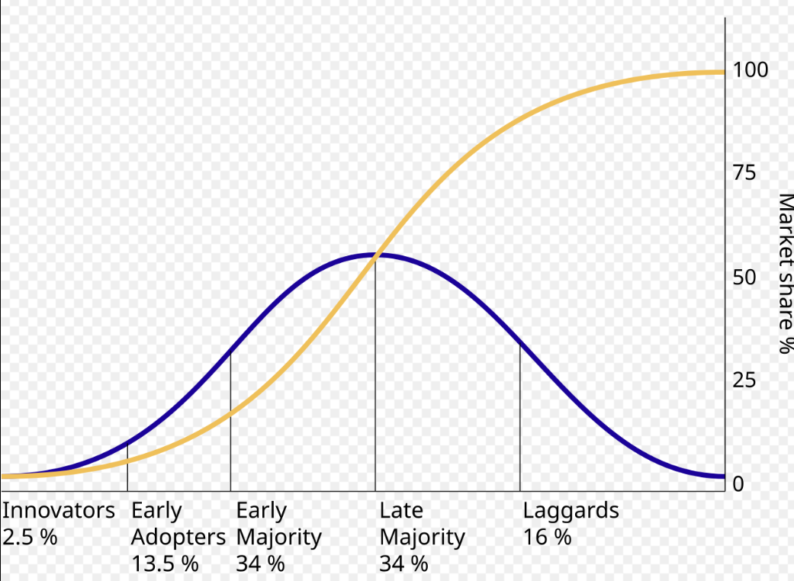
Where does this leave us?
https://b-plannow.com/en/the-rogers-curve-a-guide-to-the-diffusion-of-innovation-in-the-marketplace/
Image from Wikipedia

Slide 20
The Market
Innovators & Early Adopters
Economics as motive
Optimistic view of marketplace
“Mission”
Often ‘going big’
Political lens
Internal Politics
External Politics Less concern on operational barriers
Some states more prepared than others
For-profits, as with many things, may prove more adaptable
Others
Already have program scaffolding for TIV
Economics as deterrent
Skeptical view of marketplace
Steeper view of operational barriers
Esp re: Clock Hour
Wait and see
Contractual barriers
Resourcing

Slide 21

PCC Snapshot
Generally viewing 16 credits as ceiling
~43.6 hours wk in 11 week term, 40.0 hours/wk in 12 week term
This is both contact and non-contact hours
Anything above 16 scrutinized closer
Internal process
Lot of education / base checking
Lot of push & pull

Slide 22

PCC Snapshot
Reviewed 45+ Existing Programs
30+ Credit, 15+ Non-credit
FIPSE Grant application
Proposed several new programs, funding for implementation
0 Non-Credit programs likely to be eligible
Aside from lack of PCC infrastructure for Clock Hour TIV
3 Credit programs highly likely to be eligible
Roughly 6 others appear they could be eligible with structural change
Majority likely to fall outside
State framework, earnings, length/creds
Low enrollment as statistical/variance risk to meeting 70/70 reqs
PCC did not receive; COCC did ($2-3mil?)

Slide 23
Discussion
What is your school planning?
What are you afraid / hopeful your school might be planning without you?
Who on your campus should you be connecting with?
Actual answer will vary by school
State liaison, workforce ppl, academic ppl, your own leadership
How are folks preparing to deal with the ‘what if’ questions?
Open floor

