Slide 1
It’s Their Adventure Too: Turning Your Team Into Leaders
Presenter: Erin Swenson, MS, AFC
Assistant Director of Student Support
Portland State University
Notes:
Share about my background, relationship to leadership, journey and approach in this current position

Slide 2
Welcome to the workshop
It starts with you
What is your approach to Leadership?
Building trust
Recognition and value
Cultivating a safe and supportive environment
Collaboration
Growing others
Notes:
While the framework of this presentation is from a leadership perspective, leadership isn’t about titles. Everyone here has the ability to influence, through how we communicate, support others, and take ownership. What I’m sharing can be practiced by anyone, whether or not your role includes a leadership title. **Bulleted list is my approach

Slide 3
Building Trust
Get to know your team
  Intentional 1:1’s
  Learn about their motivations and goals
  Invite their ideas (what would you change?, what’s not working?)
  Understand their strengths
Active Listening
Follow through
Get involved
1
Notes:
Priority when I started was to meet with everyone on my team. Trust builds confidence, people disengage when they don’t feel seen or valued.
Listen to their feedback, take action to reduce pain points and gaps, get involved: I work counter shifts, take calls, do emails. Be on the front lines with them

Slide 4
Strategy: Intentional 1:1’s
Shared agenda
  Their topics
  Your topics
  Action items
1:1 Question examples:
What skills or experiences do you want more practice with?
What’s going well right now?
What’s feeling challenging lately?
What’s taking more energy?
What’s been feeling easier or more natural?
What else?

Slide 5
Think about someone you trust at work, what made that trust possible?
Prompt
30
30 seconds

Slide 6
Recognition and Value
Celebrate wins
  Create space for others to be seen and heard
  Show that leadership isn’t positional
  Supports team building
Recognition cards
  Appreciation
  Impact
  Value
2
Notes:
Who on your team already leads without the title? Invite audience to share how they celebrate wins and do recognition?

Slide 7
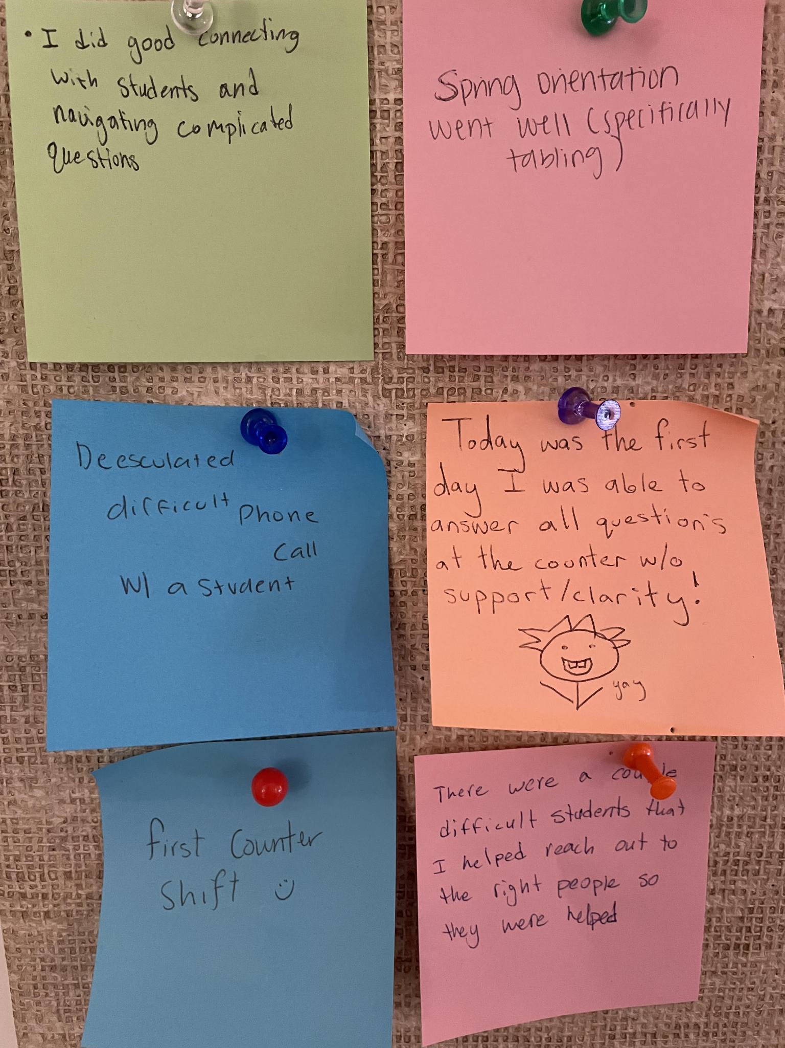
Strategy: Win Wall
What values show up most often in your team’s wins?
Notes:
Add a picture of sticky notes your team members have written “wins” on

Slide 8
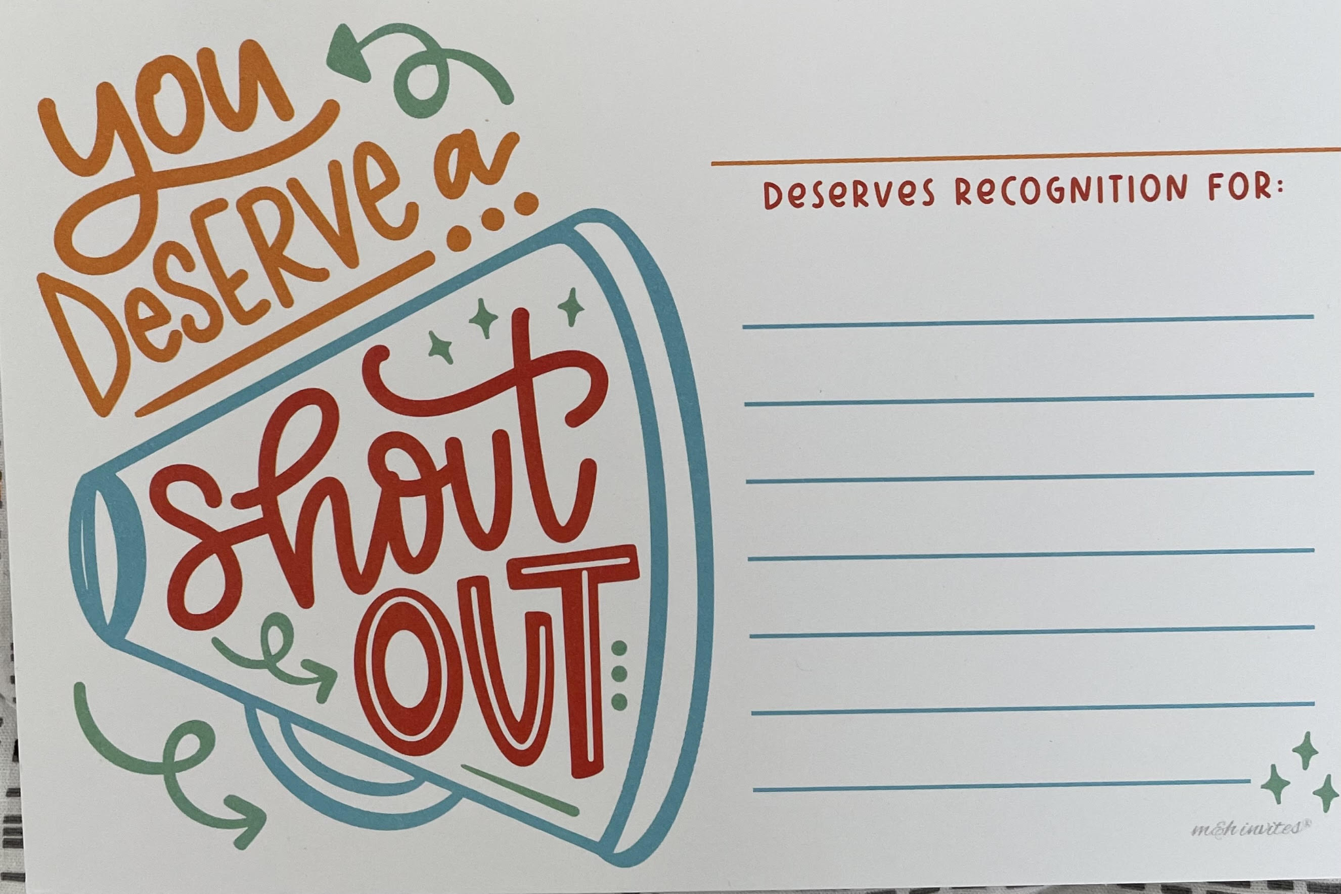
Who deserves a recognition card?
Prompt
60
60
seconds
Notes:
Circulate cards to audience, take 60 seconds, and write a thank you to someone on your team or you work with who deserves recognition - maybe they are here at conference or give to them when you return

Slide 9
Cultivating a Safe & Supportive Environment
Be flexible
Self-awareness and growth
Active listening
Use transparency
Timely feedback
Regular team meetings
Weekly Updates (google doc)
3
Notes:
People grow when they know what they are doing well, be accommodating with time off and personal needs, offer remote if possible to support a team member, communicate updates and changes consistently through team meetings or weekly updates.

Slide 10
“Please know that I deeply appreciate the work culture you have been fostering for us.”
Notes:
Feedback from a staff member on my team

Slide 11
Strategy: Open door approach
Invite team members to check in whenever needed
Notes:
More so now than ever

Slide 12
Collaboration
Share ownership
Leverage team members individual strengths
Relationship building
Create impact collectively
4

Slide 13
Strategy: Shared Projects
New Peer Advisor Curriculum
  Training plan and Onboarding
Call library
Financial Aid Scavenger hunt
Banner Bingo
FAQs
Email Best Practices Training
Notes:
Highlight how you’ve approached collaboration with your team, share examples of projects, emphasize new hires and their onboarding

Slide 14
Growing others
Create opportunities to lead
  Accountability
  Ownership
Career Conversations
Identify skills they are cultivating daily
  Empathy
  De-escalation
  Managing stress
  Written and verbal communication
  Troubleshooting
5
Notes:
Many staff don’t realize they’re already leading, your job is to name it. Created opportunities for staff to table at events, present, mentor new hires, train, attend conferences

Slide 15
Strategy: Individual Projects
Autonomy
Creativity
Skill-building
Manage timeline
Follow through
Accountability
Engagement
Tuition Free Degree - Old Maid
FAFSA Jeopardy
Emergency Fund Resource Guide
Notes:
Share how during slower times in Fin Aid, you invited your team to do individual projects on a FA topic or process improvement they were interested in, you allowed them to be creative with it, now you have a g-drive of of decks and engaging activities for new hires and refreshers for current team members
Highlight the skill-building involved in individual projects

Slide 16
When was the last time you asked a team member where they wanted to grow?
Prompt
60
60
seconds

Slide 17
Erin has always encouraged me to consider professional possibilities that align with my interests and strengths, while also helping me think outside the box about my professional future. I have always felt valued, trusted, and gently pushed to achieve my full potential.
Notes:
Feedback from a staff member I lead

Slide 18
Develop leaders alongside you
You gain capacity
Individuals build confidence
Team culture strengthens
Engagement increases
Impact!
Notes:
Takeaways

Slide 19

OASFAA Win Wall!
Share a recent example of leadership in your work!
Notes:
Have sticky notes at table, Invite audience to answer the prompt and put post it’s on white board
(or wall of conference room) - take a photo of all stickys, invite a few folks to read there’s first
Examples: did you take initiative to make something happen, supported a teammate, student, or process, solved a problem or guided a decision
made an impact that inspired or empowered someone else

Slide 20
Thank you!
Reach me at:
swen3@pdx.edu

