Slide 1


Never Say Die When it Comes to Taking Care of Business Presented by Kella Helyer, FAD, WOU Jennifer Birt, Asst. DFA, WOU Thursday, January 29, 2026 10:30-11:20 AM in the Gallery

Slide 2
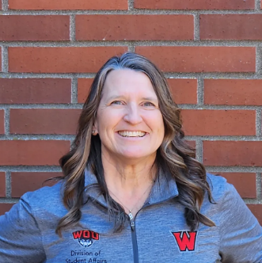
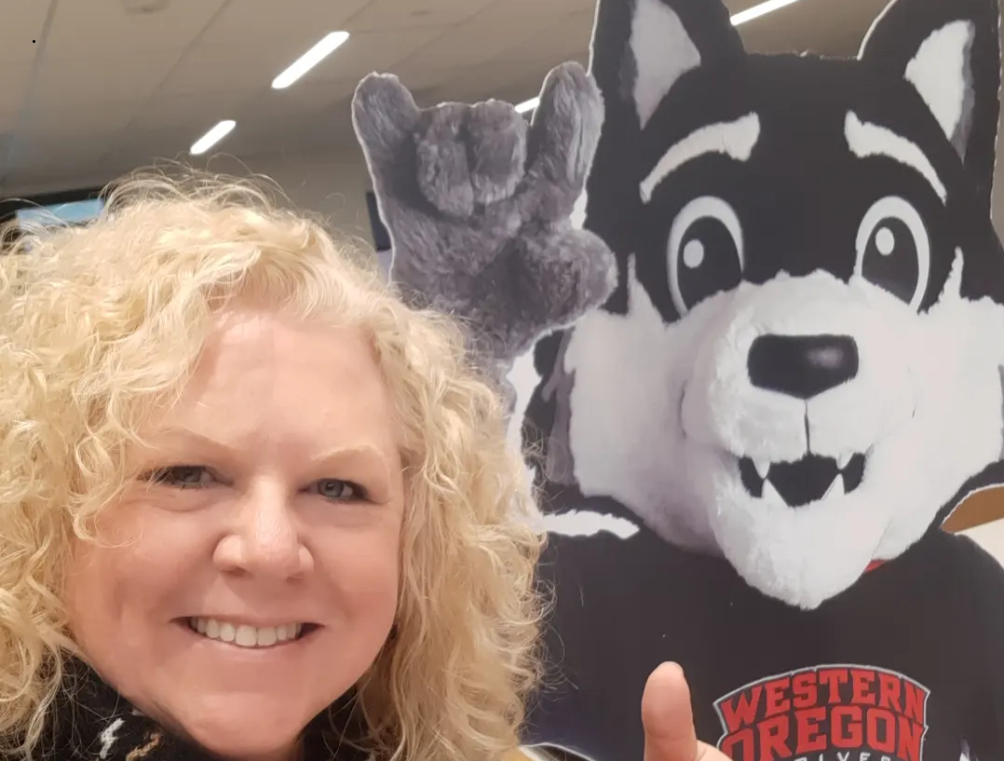
About us – Presenters From the financial aid office at Western Oregon University
Kella Helyer, Director
Jennifer Birt, Assistant Director

Slide 3
Agenda
How are you taking care of your staff
How are you honoring and empowering them
Have you discovered the hidden treasure in your office is your staff
Ways to engage staff, show appreciation, and get the best from them

Slide 4

Catch a Wave! How are you taking care of staff?

Slide 5

How are you honoring and empowering them?
Confidence-building strategies

Slide 6

Have you discovered the hidden treasure in your office is your staff?

Slide 7

Ways to engage staff, show appreciation, and get the best from them.

Slide 8

Reveal your Hidden Treasures – lessons learned
Different attempts – “catch the next wave brah”!
One way doesn’t always work, try different ideas.
Walk up songs
Not everyone wants to engage
Teamwork makes the dreamwork
Homecoming décor / Christmas decorating
Opportunities to engage on campus (choir, athletics)
“Parking lot” ideas
Change management – team rebuilding, create an environment

Slide 9











Ideas, Tips & Take-aways!

