Slide 1

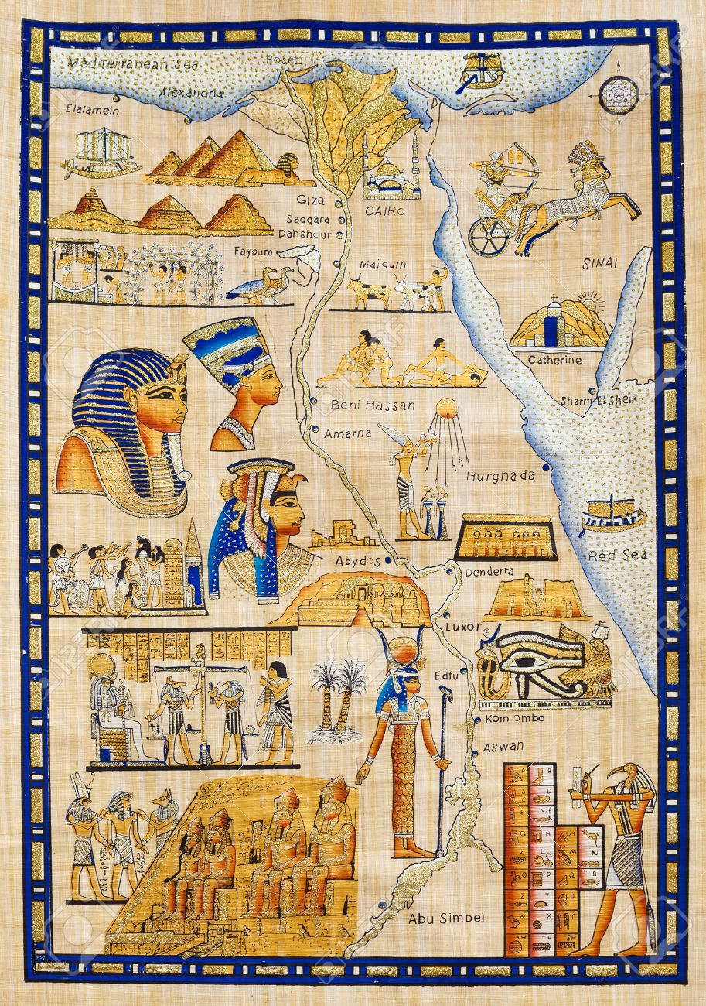
Reflection & Exploration: The Building of Interpersonal and Institutional Legacies
Marvin sadler, MPP
Portland community college

Slide 2
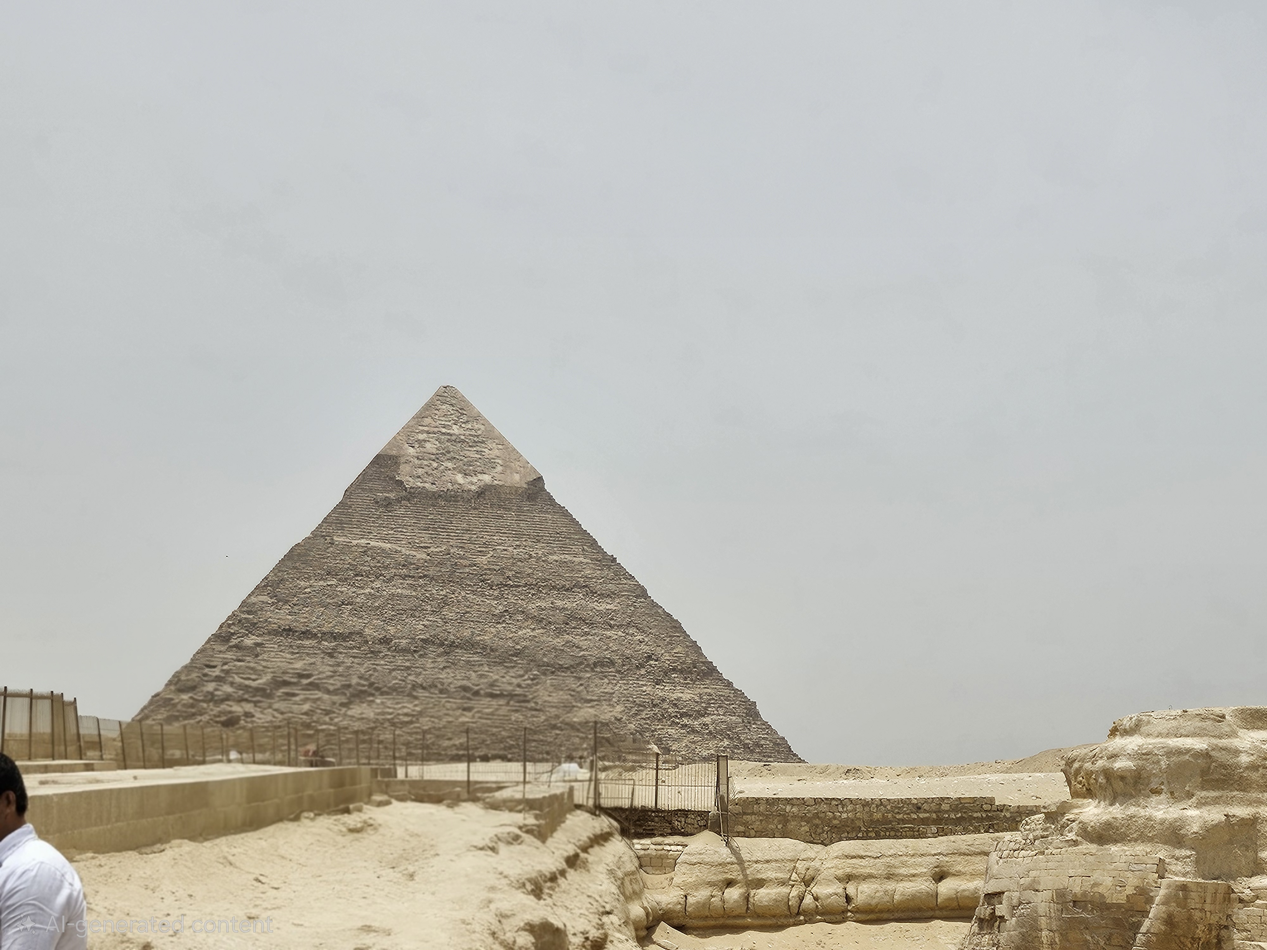
PYRAMID STRUCTURE
AVP
Ryan Clark
DEAN/DIRECTOR
Peter Goss
MANAGERS
Shauna/Sarah, Rebecca, Carlos
COORDINATORS
Maureen, Heather, Nicole, Rachael, Lena
SYSTEMS TEAM
FINANCIAL AID ADVISORS
FINANCIAL AID TECHS
(Little ole Marvin)
Assoc Vice President – Ryan Clark
Dean/Director – Peter Goss
Manager – Shauna/Sarah, Rebecca, Carlos
Coordinator – Maureen, Heather, Nicole, Rachael, Lena
Systems Team
FA Advisors
FA Techs (Little ole Marvin)

Slide 3
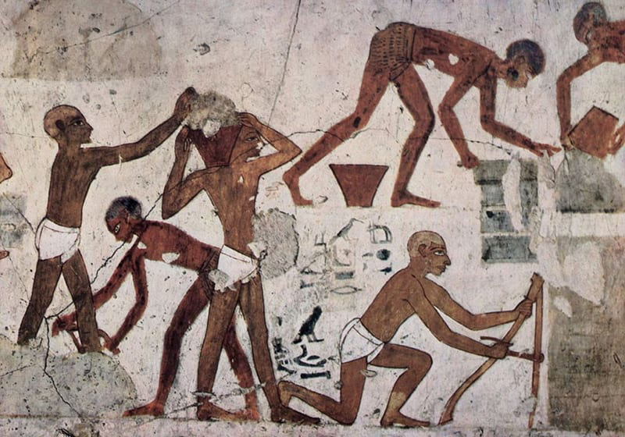
INSTITUTIONAL LEGACY
It is estimated between 15,000 – 20,000 people lived in a community to build the Pyramids in Giza Plateau.
Think of your institution as the Pyramids:
Attraction
Belonging
Community
Greatness!
Students Personal Building (Legacy and Foundation)
https://www.thecollector.com/12-objects-from-egyptian-daily-life-that-are-also-hieroglyphs/

Slide 4
American Association of Collegiate Registrars and Admissions Officers
2022-2023 Academic Year Demographics of Community College Students:
The average age is 28, underscoring the high number of adult learners
Approximately 72% of students attend part-time, often balancing work or family responsibilities.
Nearly 80% are employed while enrolled.
Around 45% are first-generation college students, navigating systems without prior family experience in higher education.
AACRAO, (2025, April 28) Community colleges: A legacy of access, equity, and Innovation. https://www.aacrao.org/resources/newsletters-blogs/aacrao-connect/article/community-colleges--a-legacy-of-access--equity--and-innovation

Slide 5
INSTITUTIONAL LEGACY & PRESTIGE:
Definition: Institutional legacy is primarily defined as by student’s family legacy (i.e. legacy in admissions) leading to students gaining additional points for entrance into the college/ university of choice. Legacy can be influenced by multi-generational family history attending an institution, family endowments, political power, fostering close long-standing relationships within the institution and more.
Institutional Prestige is built by the institution’s reputation within academia and/or the job market (i.e. PCC’s Nursing Program).

Slide 6
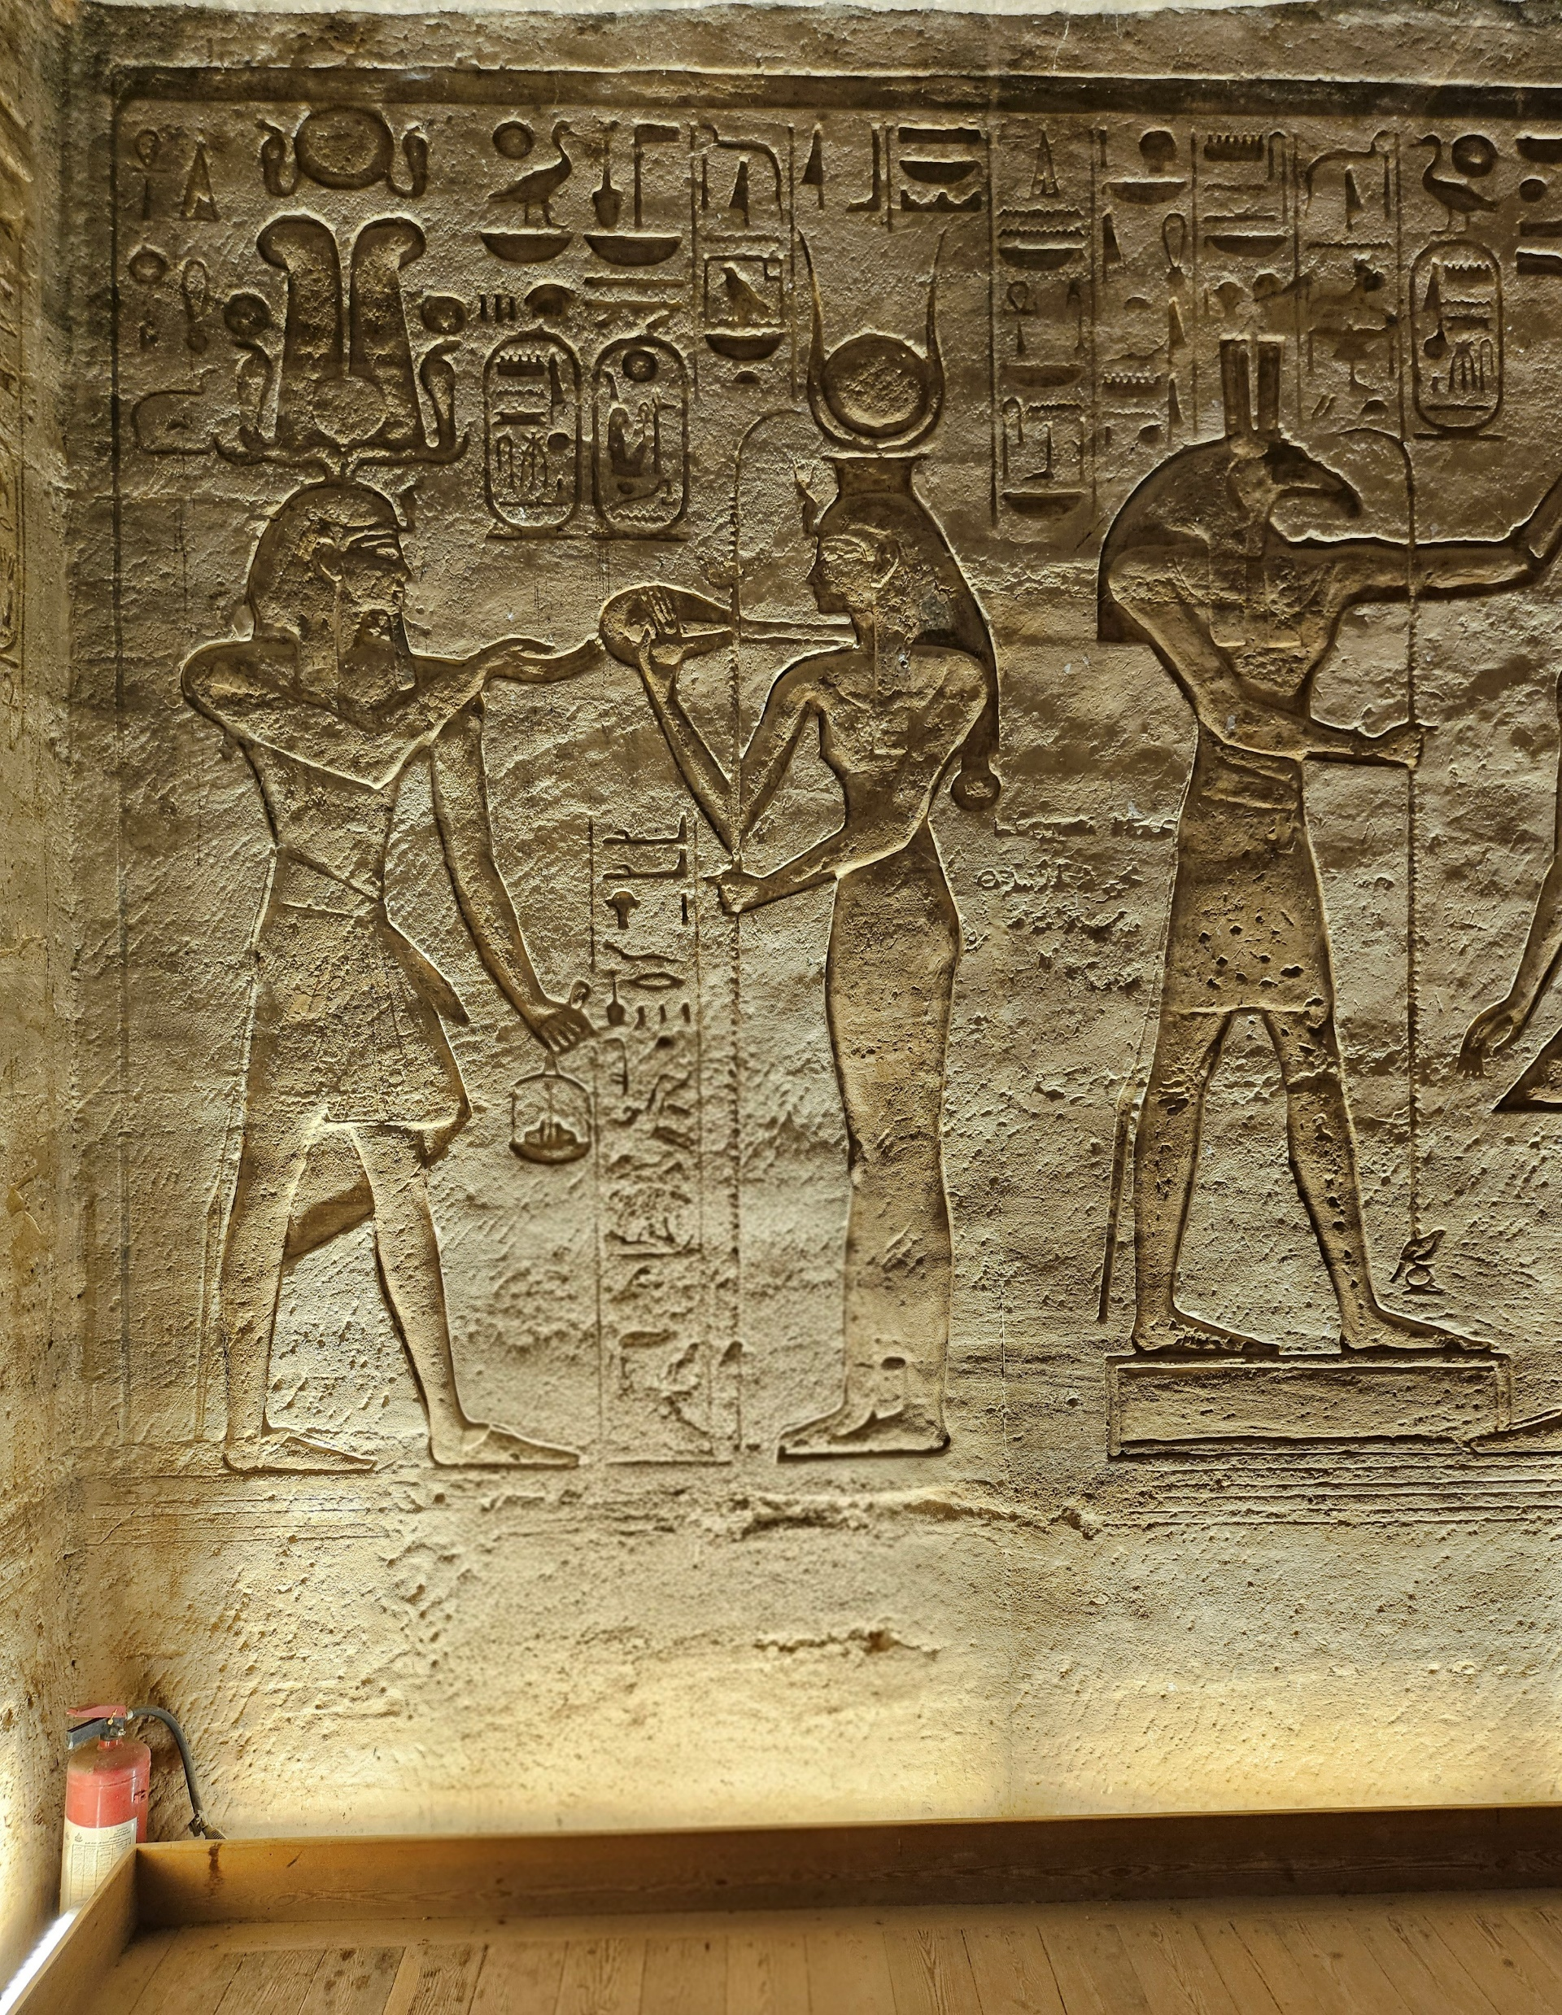
INSTITUTIONAL KNOWLEDGE
Where is your institutional knowledge stored? i.e. Spaces
Ask Regs?
NASFAA?
Post-it notes?
Does one person manage it or is it collective?
How often is the information updated?
How is it passed on to current and future staff members?
Thoth – The God of Writing , Knowledge and Record Keeping
Ramesses II & wife Queen Nefatari, God Thoth at Abu Simbel

Slide 7
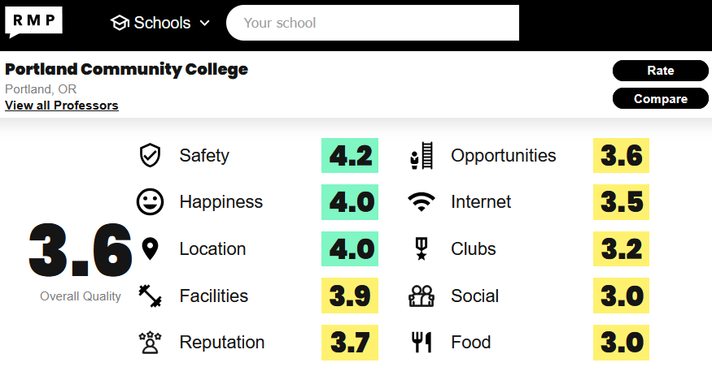
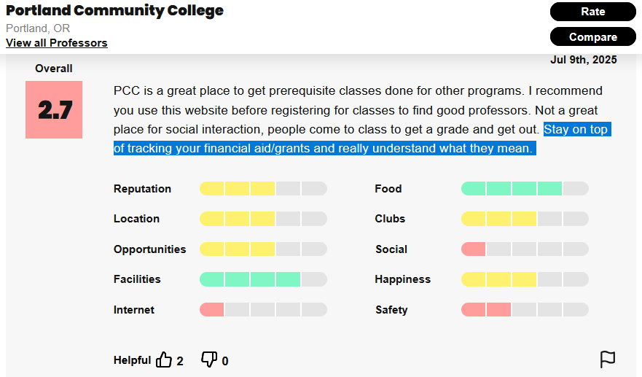
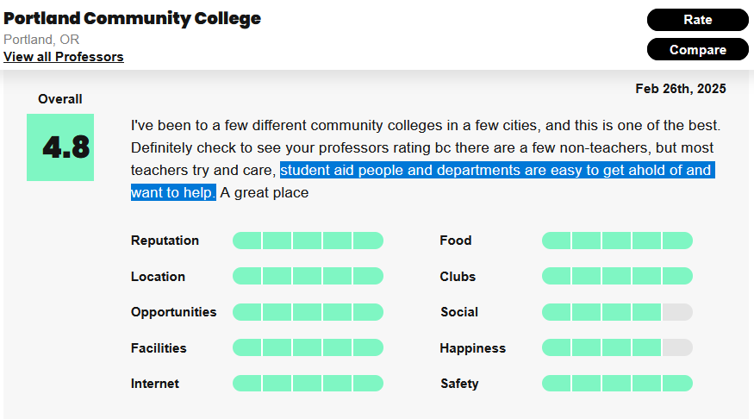

Slide 8
PERSONAL LEGACY
FINANCIAL AID TECHS
(Little ole Marvin)
FINANCIAL AID ADVISORS
COORDINATORS
MANAGERS
SYSTEMS TEAM
DEAN/DIRECTOR
AVP
THE STUDENT EXPERIENCE
REVERSE PYRAMID STRUCTURE:
FA Techs (Little ole Marvin)
FA Advisors
Coordinator – Maureen, Heather, Nicole, Rachael, Lena
Managers – Shauna/Sarah, Rebecca, Carlos
Systems Team
Dean/Director – Peter Goss
Assoc Vice President – Ryan Clark

Slide 9
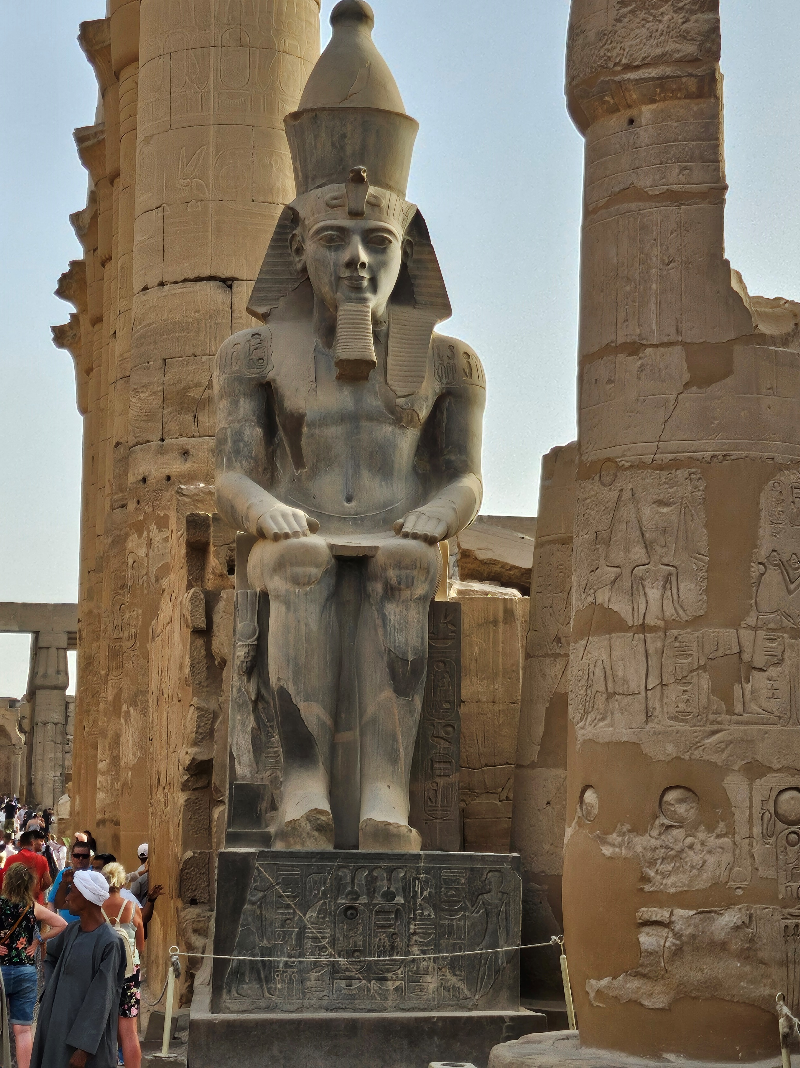
It is all of our responsibility but know your limits
Under-promise and over-deliver
It is not your job, but ….it is your job!
Giving our students and parent the best of us in every interaction leaves an everlasting impression
Be Impactful
DON’T BE AFRAID TO TELL YOUR STORY!
Make one-on-one moments count when with a student
Community Visibility (Do not shy away from being a bridge between your institution to students and families)
Relationship Building
FA relies heavily on connecting with peers to problem solve
Students are equally important to relationship building for problem solving (ex: 2425, 2526 FAFSA!!!!)
Mentorship
Students of Various Age Groups (traditional and non-traditional)
Staff (within and outside of your department)
Share kindness, wisdom, life lessons, positive reinforcement
Ramesses II Pylon at Luxor Temple

Slide 10
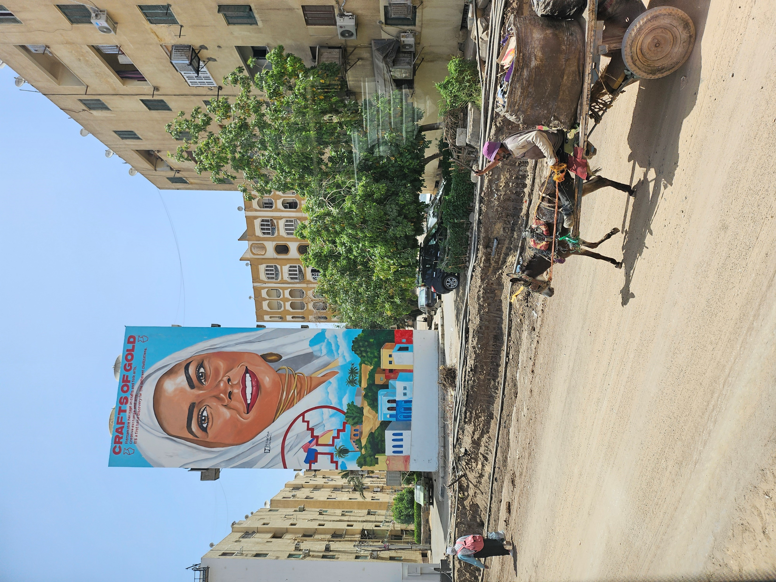
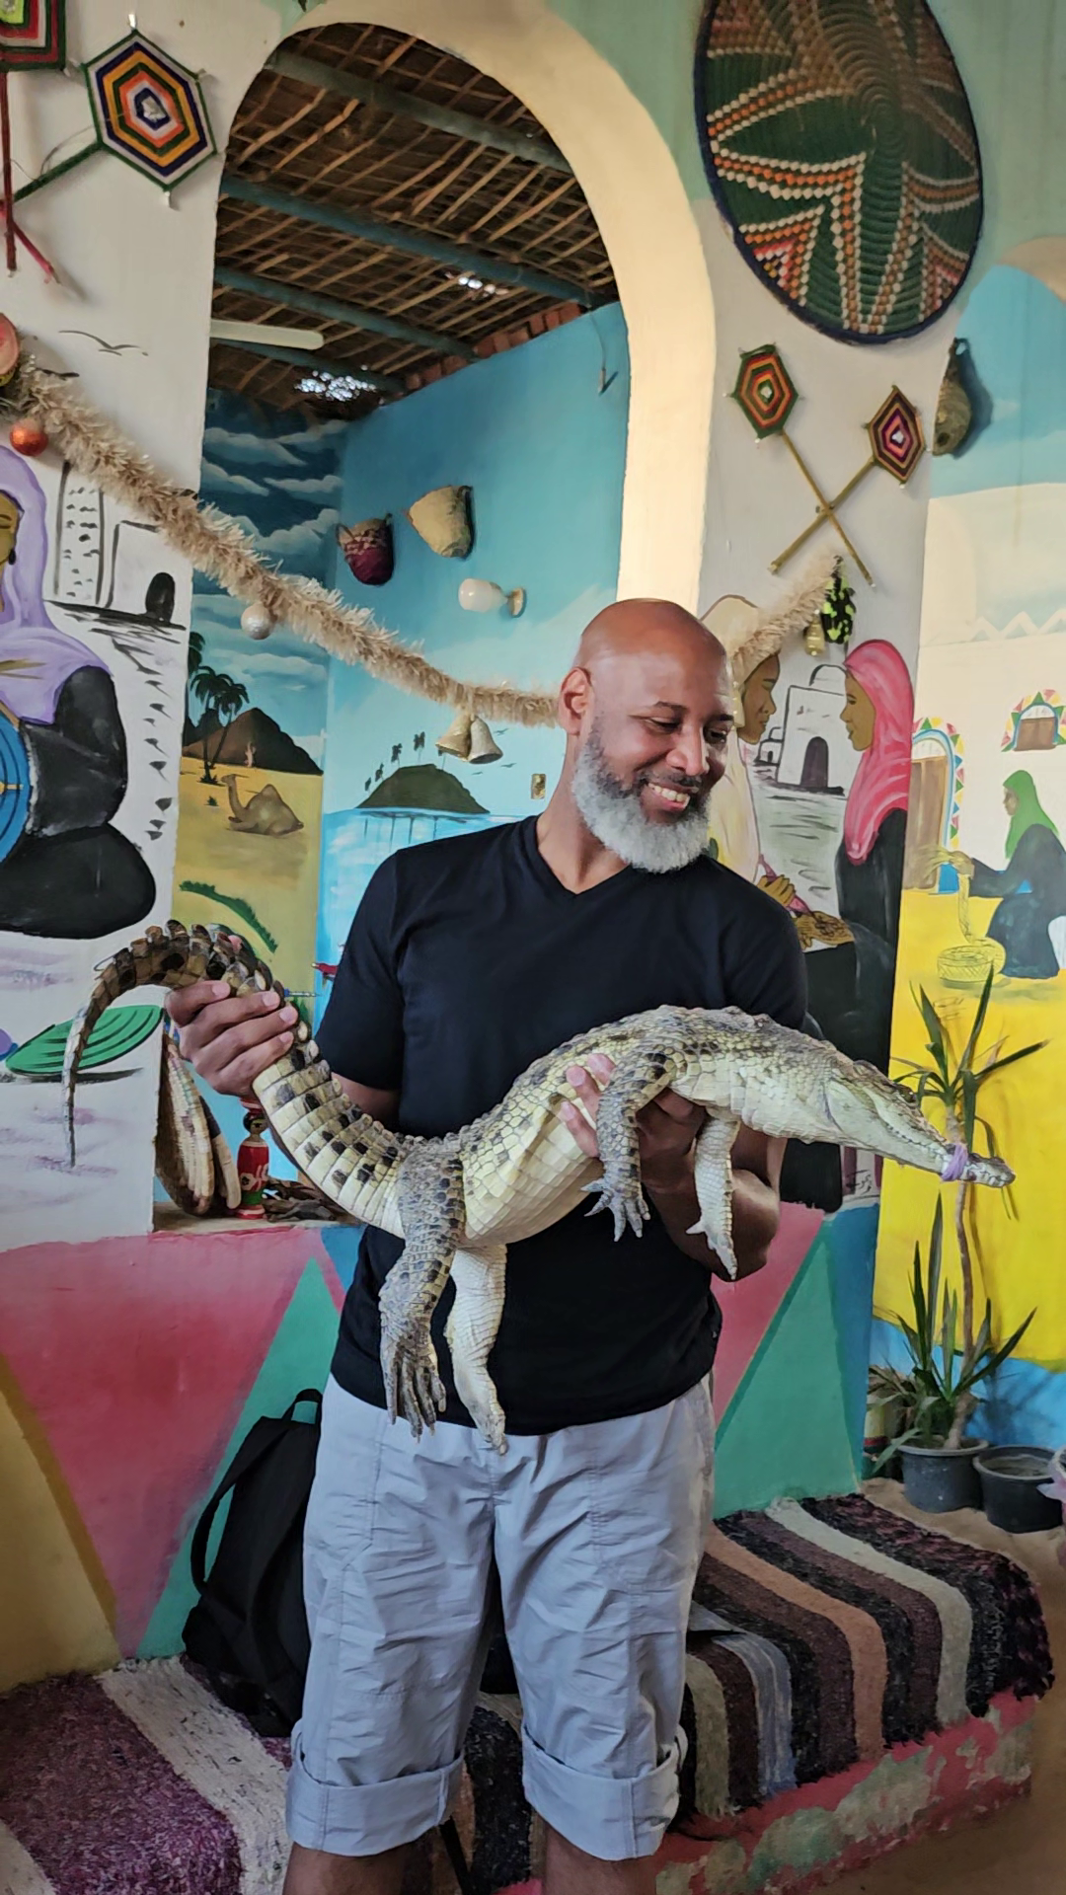
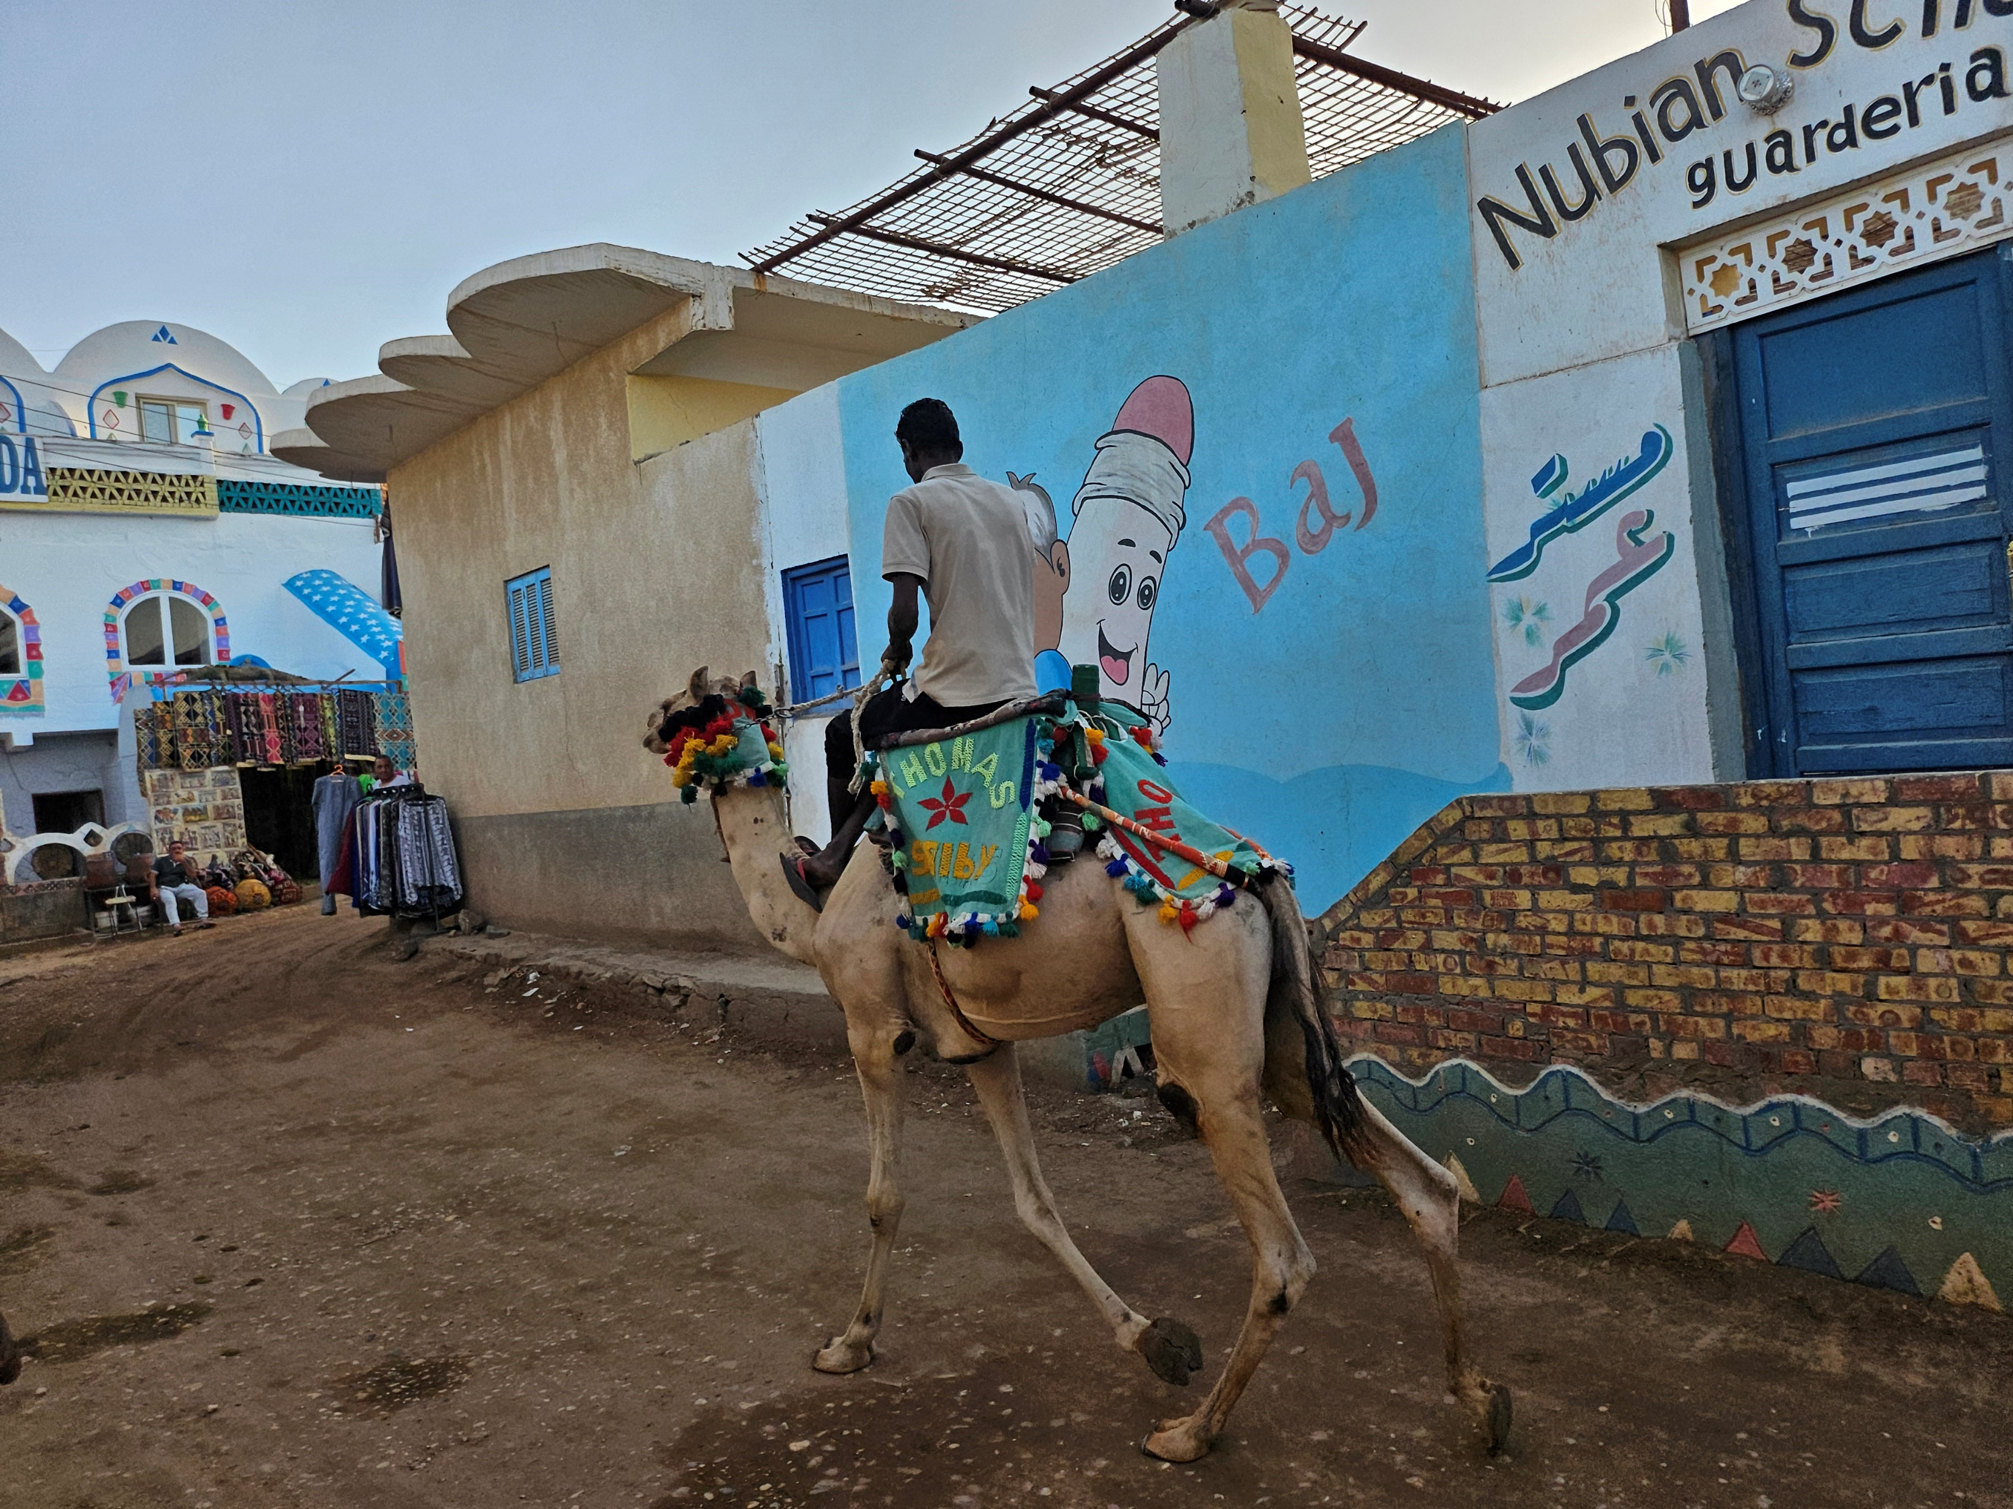
Aswan Village (Original Nubian People)
Ancient Roots: The Nubian people are one of the world's oldest civilizations, with origins tracing back to the Neolithic period, predating modern Egypt
Kushite Kingdom: Nubia (Kush) was a powerful kingdom, even ruling Egypt as the 25th Dynasty (Black Pharaohs) for a time, with rich cultural exchanges with Egypt
Core Principles and Practices:
Balad El-Aman – Land of Peacefulness and Security
Welcoming to all individuals
Share 1.5 percent of personal wealth with their people
Building Strong Community
No neighbor goes hungry
No one will be in-need

Slide 11
Five Steps To Build Your Legacy and Why It Matters
1. Build Your Legacy By Being the Person To Others that You Once Needed
While confronting adversity can be extremely challenging, learning to move through adversity helps us develop resilience and perseverance. The beauty is that the more you overcome adversity, the more you can learn to embrace adversity for all the lessons gained. It is the lessons gained that you can share and pass on.
2. Spread Joy
When people associate you with positive feelings they want to see you, spend time with you, and are more willing to help you when you need them. More importantly, they benefit from enjoying your company. You make them feel good about themselves, their relationships, and life in general.
3. Share Your Talents and Gifts
Don’t discount your talents and gifts and the power of sharing your gifts and talents with folks. It can be easy to discount your gifts and talents when they come easy to you or seem like no big deal. If someone has told you that you are great at something, believe them.
4. Be Authentic and Find Your Tribe
There is someone out there for everyone. The sooner you learn to embrace and love yourself and honor who are through authentic interactions, the sooner you’ll find your tribe—and possibly even your gifts.
5. Give Back
Find a cause or several causes that you have personal experience with or that resonate with you for a compelling reason. By making financial contributions, volunteering on the ground, or serving in a more strategic capacity.
Lozupone, Ja’Bette (2022, May 1). Five Steps To Build Your Legacy and Why It Matters. https://wishfuldoings.com/build-your-legacy/

Slide 12
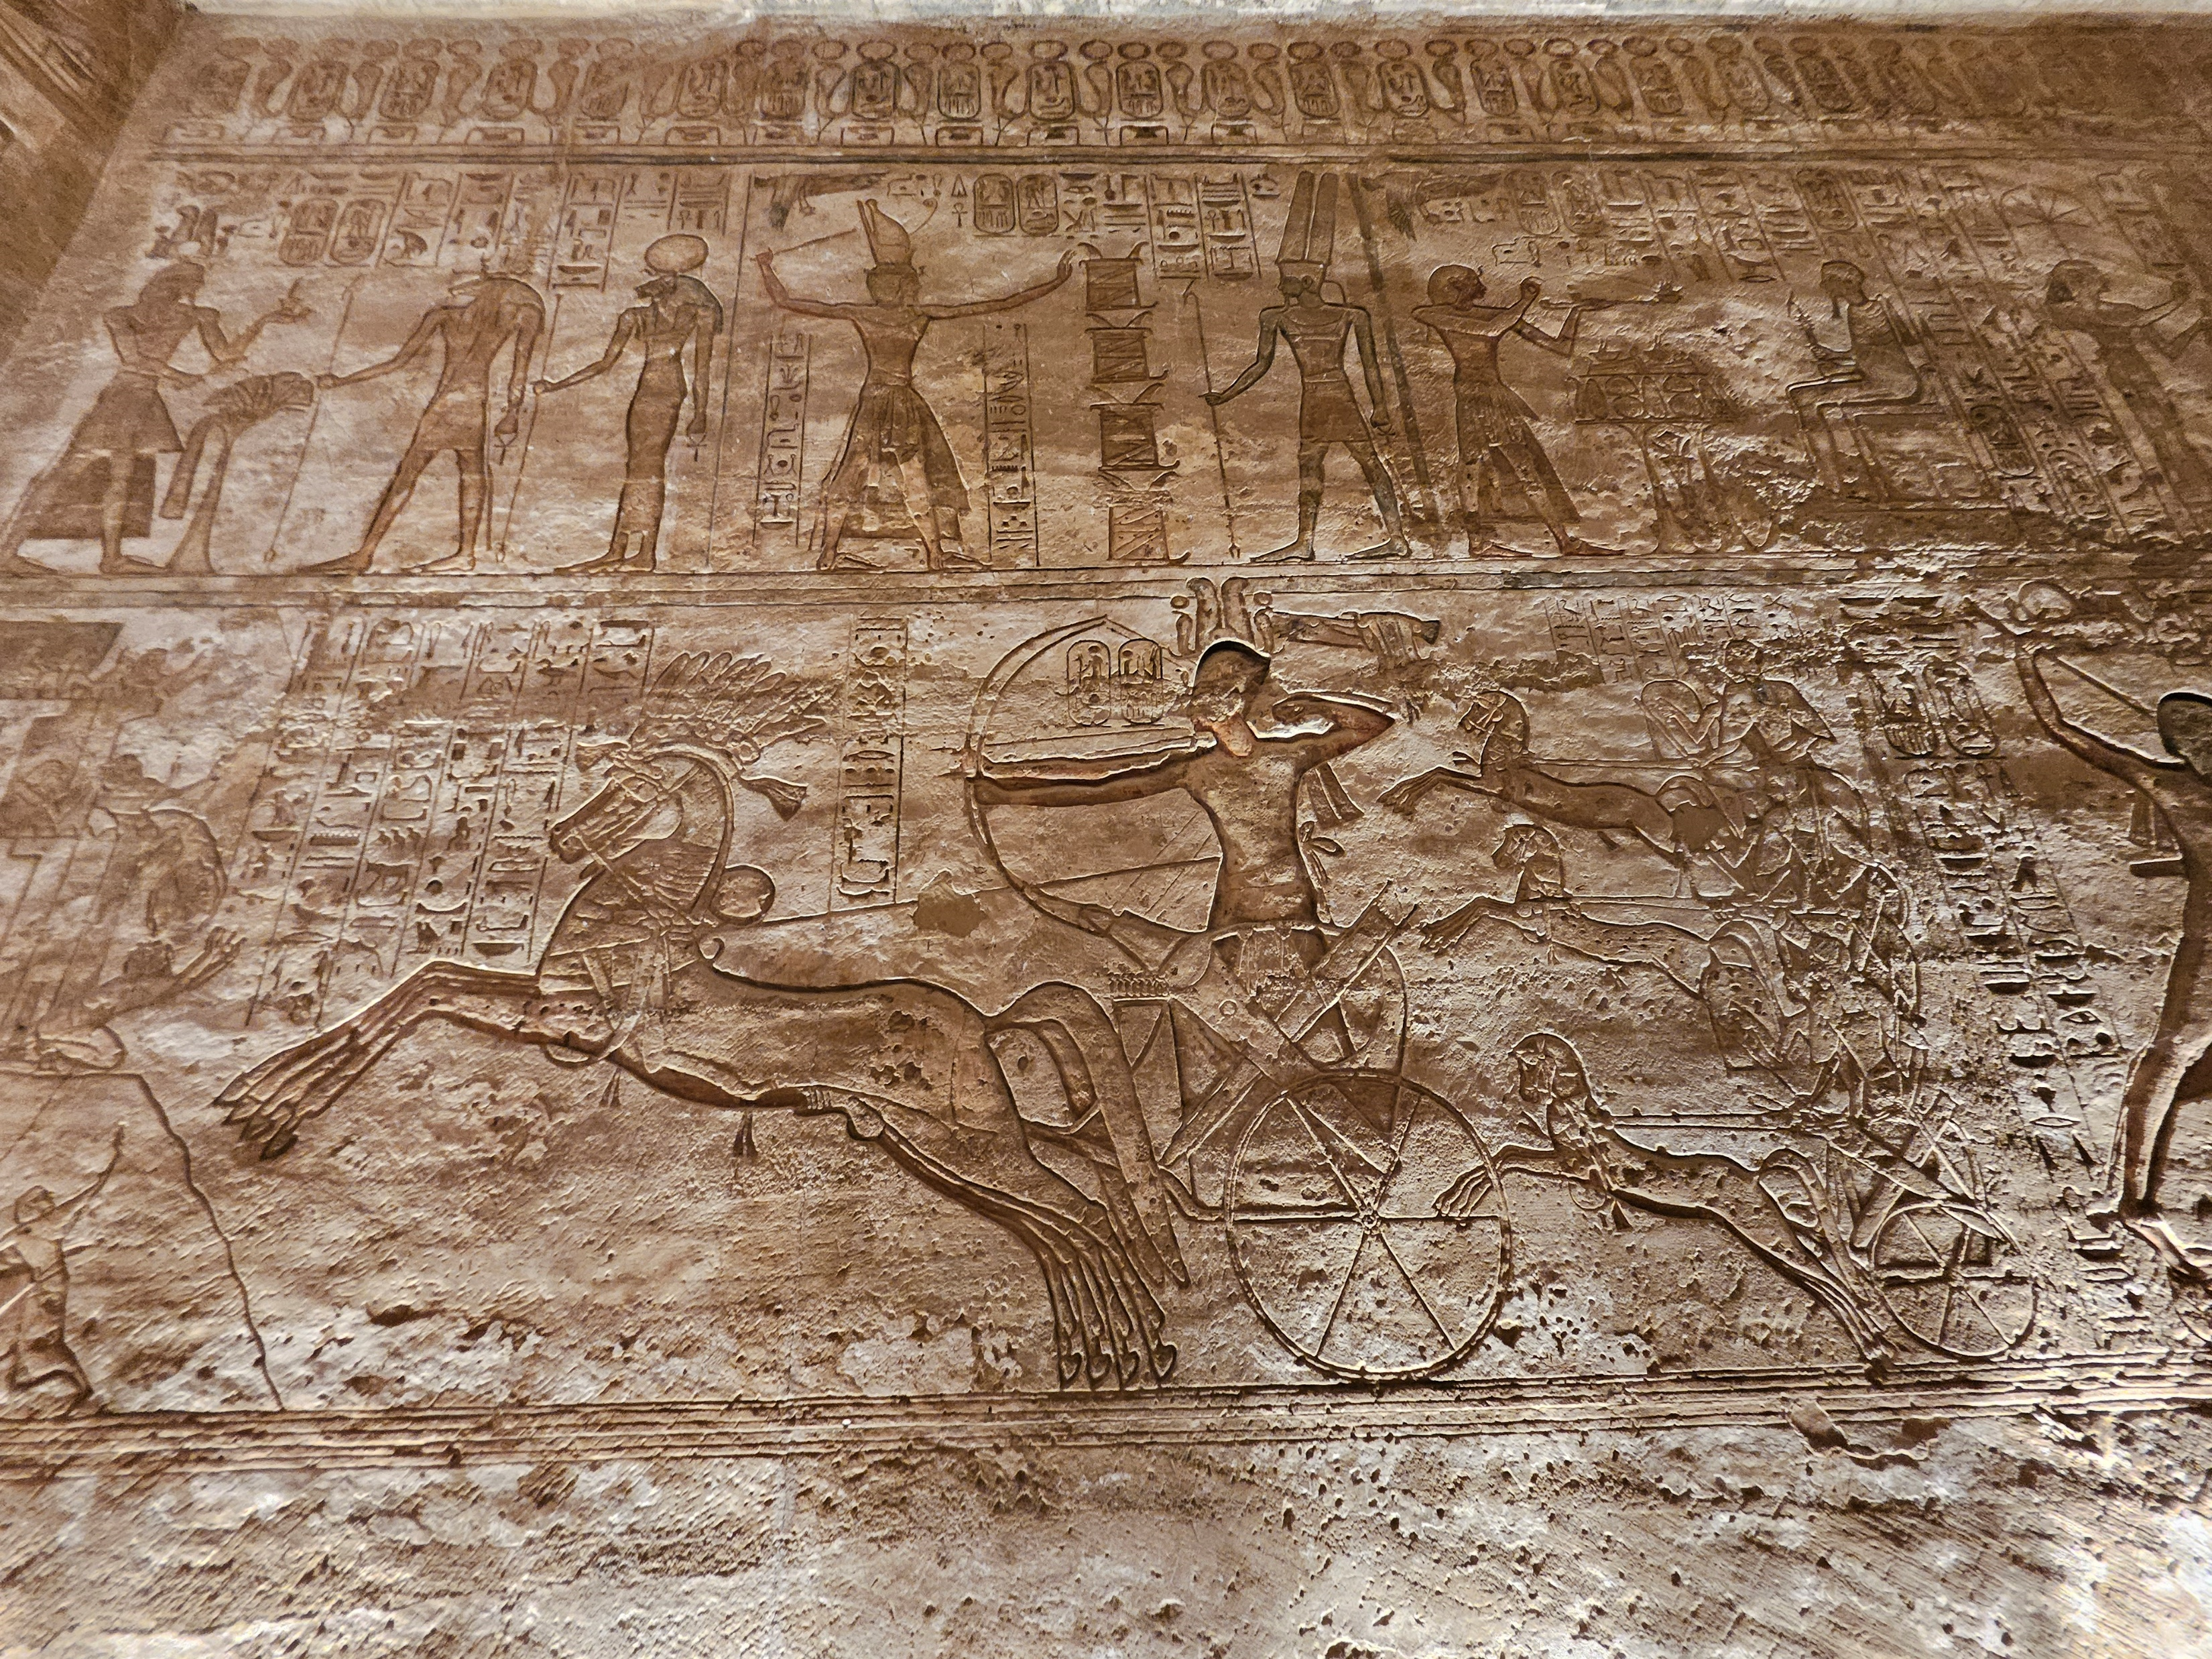
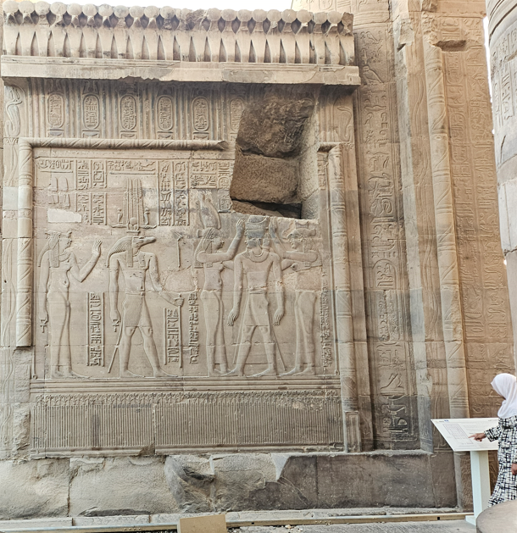
WHAT DO YOU WANT THE HIEROGLYPHS TO READ ABOUT YOU?
Ramesses II in Battle - Temple of Ramesses II at Abu Simbel
Double crowning of a king with the goddess Seshat during the Ptolemaic Era at Kom Ombo Temple - Aswan

Slide 13
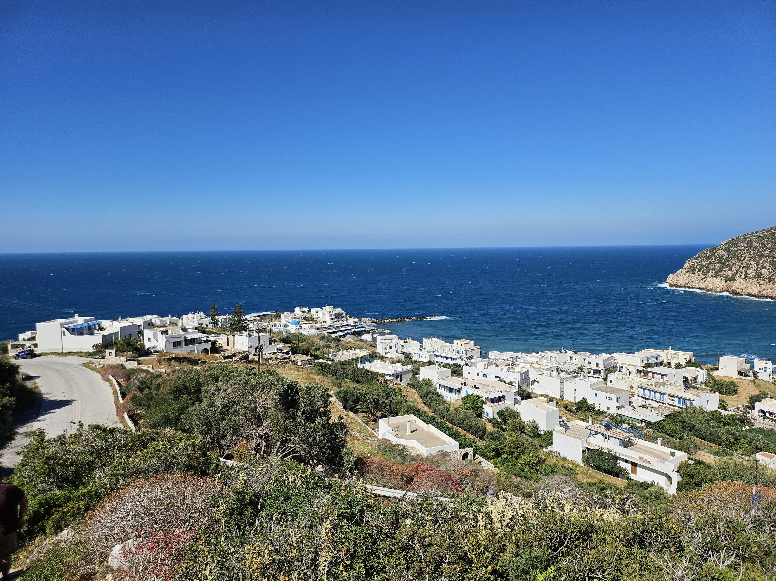
THANK YOU FOR ATTENDING TODAY!
Overview of the island of Naxos, Greece
marvin.sadler@pcc.edu

