Slide 1
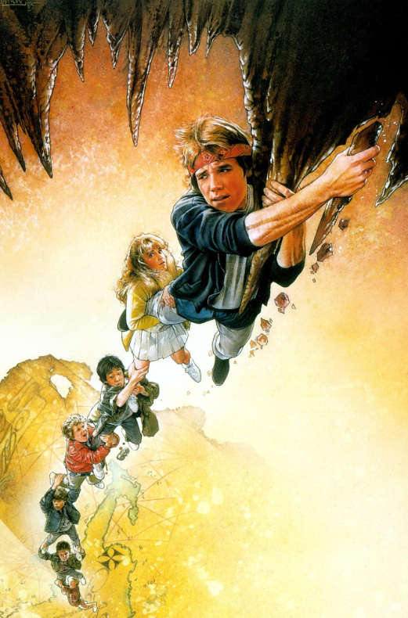
Conflict Management:
Climbing The Ladder of Inference out of the Inferno
Peter Goss
Trivia Question: What is ‘The Inferno”

Slide 2

Pre-test:
1) What percent of your thinking/behavior would you say is:
Rational / intentional vs
Reactive / automatic
2) How do you feel about conflict:
Positive
Negative
Other
3) Cross-over with implicit bias work

Slide 3
Road Map
The human brain / nervous system
Why we can never be fully rational
The Ladder of Inference
Unpacking not jumping to conclusions
Conflict buckets
Productive conflict
Conflict conflict
Conflict, take two

Slide 4
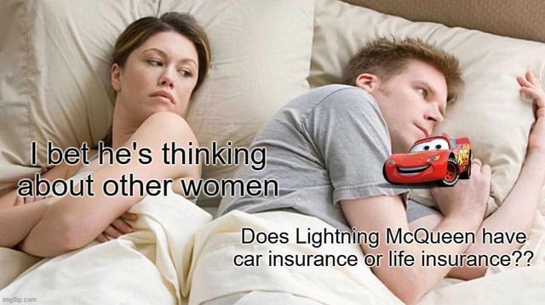
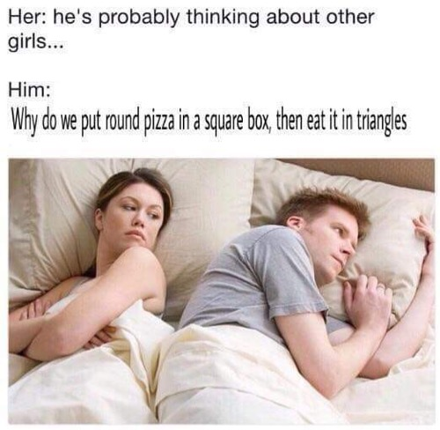
Brain: Story Telling and Making Meme-ing
Nail on the head
What information are we gathering
What inferences/conclusions are we drawing?

Slide 5
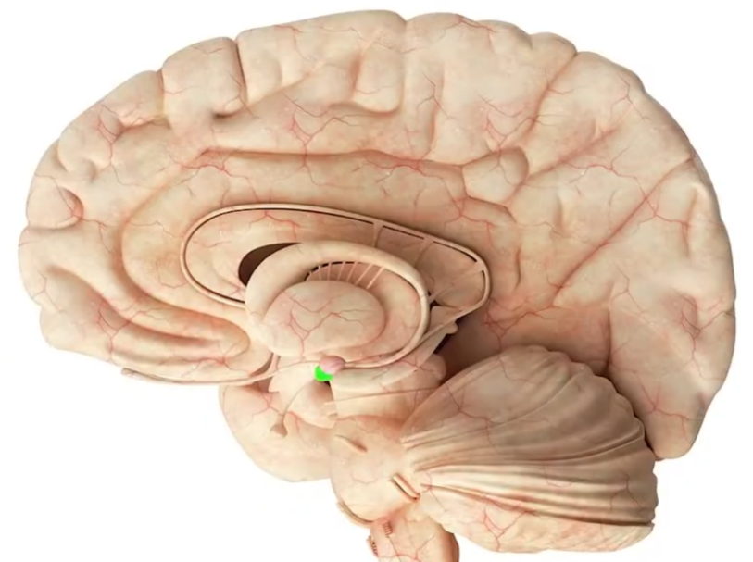
The Brain: Lizard Brain
The Amygdala
- Right and Left
- Encodes emotion to stimuli
- Links emotions to memories
- Prioritizes information for survival
- Social processing
- Anxiety and adrenaline
- Fight or flight response

Slide 6
The Brain:
Amygdala Hijacking
Suppression / co-option of PFC
It doesn’t mean you stop being a rational person
There are things to be rationally angry about
But trying to hold cognizance that we may be getting mis-steered even just a bit

Slide 7
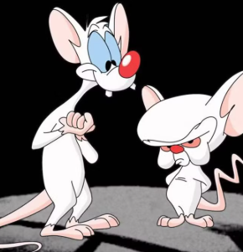
The Brain: Two Systems
System 1:
Autonomic functions
Intuition
  2+2=4
Impulse
System 2:
Analysis
Computation
  17*42=?
System 1 dominance is in the interest of efficiency
System 2 requires effort / intent

Slide 8
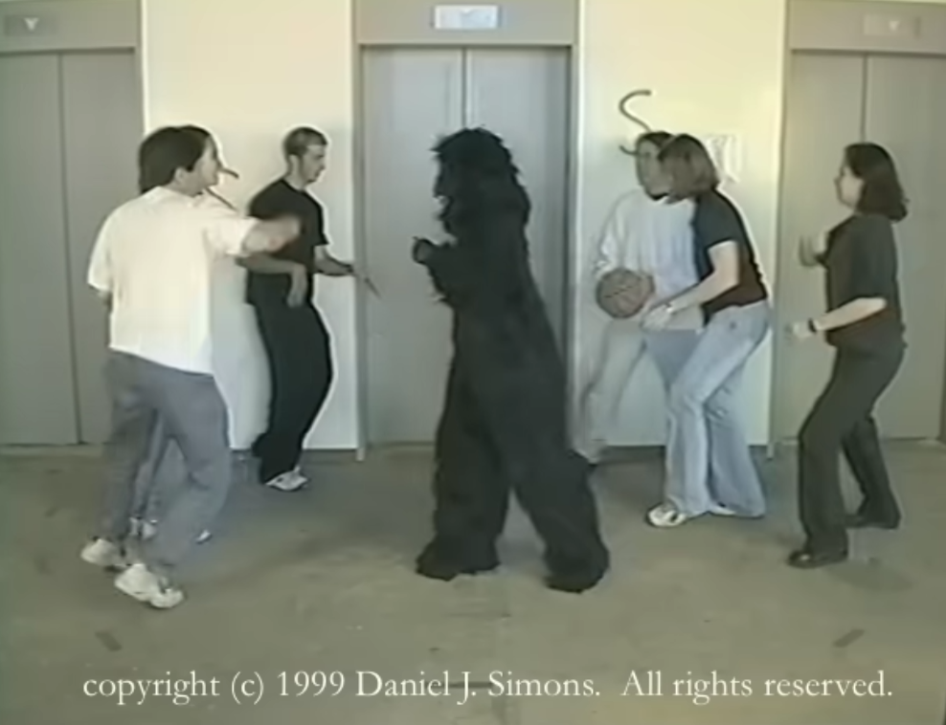
The Brain: Two Systems
Big caution: We are not always cognizant of which system is predominant
“A bat and a ball cost $1.10 in total. The bat costs $1.00 more than the ball. How much does the ball cost?”
Airport pickup
The Invisible Gorilla
Loan limits
  When Congress changes them

Slide 9
The Brain: Two Systems
System 1 is not inherently bad
  Illinois driving anecdote
System 2 is not inherently right
  Brain internally still has a load limit
  External tools
Recognize when mistakes are likely and stakes are high
Both are subject to limitations
  Pupil dilation
  Practice or skill / ability expand capacity
2 + 3
42 * 17
2,432 * 356
4296
Memorize the string, recall after 60 seconds
*Add 1 to each digit
* Add 4 to each digit

Slide 10
The Brain: “the gut”
The canard: “Your gut is right 90% of the time”
Not actually a scientifically derived number
The ‘chess master’ example
  Someone with expertise
  Making decision in their field of expertise
  Not the same as a random person self-diagnosing a cough
Worth erring (to a point) when safety is in question
“We can be blind to the obvious and are also blind to our blindness” – D. Kahneman

Slide 11
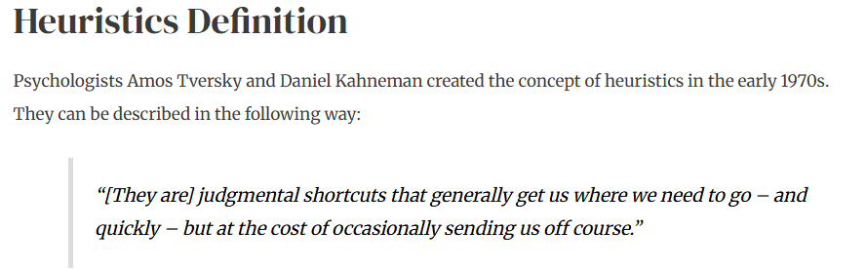
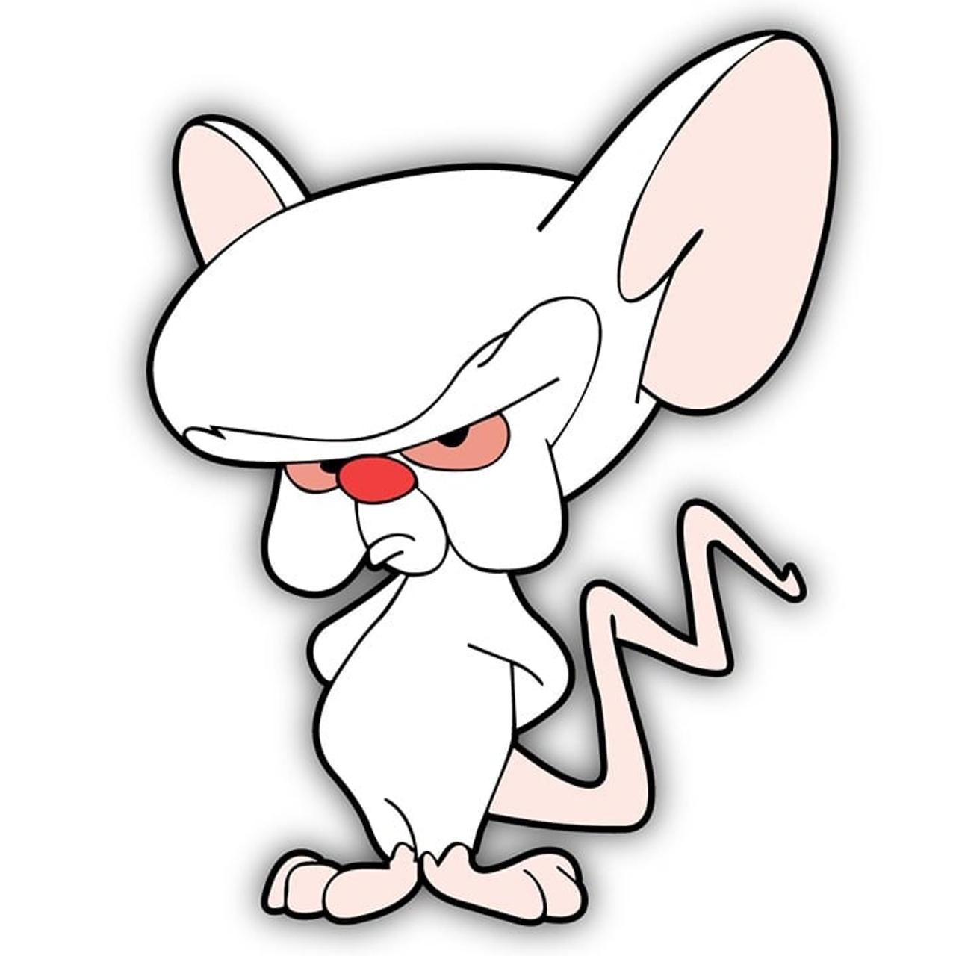
The Brain:
Heuristics
“Strategy which ignores some information in the service of speed in decision-making”
A few heuristics to touch on:
Availability
If something is more available in memory we act as if it is more likely to be true
  Emotive impact
  Recency
Anchoring
Tendency to overweight the first piece of information we receive
JC Penney & College Tuition. Glade Plug-Ins

Slide 12
The Brain:
Heuristics
“Strategy which ignores some information in the service of speeding decision-making”
A few heuristics to touch on:
Familiarity
Familiar is safe, e.g. branding
Representativeness
Judging likelihood
  by comparing to a prototype, e.g. bias: perceived group membership predicting individual behavior
  Gambler’s fallacy: past behavior representative of future results

Slide 13

The Brain: Ambiguity Aversion
Estimates vary, but
~30-50% of ppl are averse to ambiguity at all times
Aversion increases to roughly 70-80% when under stress
Conflict across the ambiguity line
FA work is a mix of the certain and the ambiguous
  Risk management, for example is highly ambiguous even with math
Post-covid: dysregulation, distrust, disconnect (B. Brown)
  Or put another way, our sense of who is ‘on our team’ has shrunk

Slide 14
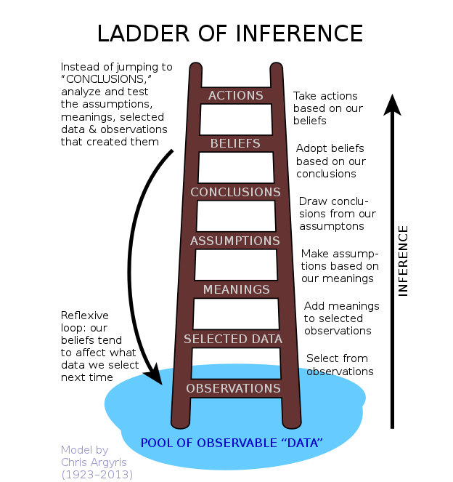
Ladder of Inference
What did I observe?
What data did I select?
  What data did I omit?
What meaning did I derive?
What assumptions am I making?
What conclusions am I drawing?
What are the resulting beliefs / actions?

Slide 15
Ladder of Inference
Observable data IN THEORY is the foundation
Meanings : initial interpretation of data
Beliefs : accumulated, reinforced which inform future observation
The LoI model gives us distinct steps between observation and action (or conclusion) to interrogate
  “Don’t jump to conclusions” less so
Model has applicability for implicit bias and many other human-doings
Particular use in situations of ‘conflict’ where we may be under stress

Slide 16
Ladder of Inference
What parts of the ladder would you assume are System 2 vs. System 1?
  The reality is, if you let it run System 1 will go all the way up the ladder
  With intentionality, all steps can be System 2
  That does not guarantee no error, but it is still a shift
  ‘Airport pickup’ redux
  Invisible Gorilla, take two

Slide 17
Ladder of Inference
Imagine a situation of explicit or embedded implicit bias
Callback to our Availability Heuristic
If belief is already coded in…
Liable to drive observations to a limited subset of data:
  Include [group identifiers]
  Conclude certain predictions
  Act
  Ignore actual behavior, context, etc.

Slide 18
Ladder of Inference
Imagine a situation where the action is you’re in a team and someone says “You always reject my ideas”
  Working up the ladder
  Working down the ladder
What questions would you have?

Slide 19
Ladder of Inference
If we know we’re stuck in System 1 how do we temporarily get out?
  Pause
  Walk
  Breathe
  Reflect
Many of your colleagues (and probably you) will have better ideas on this

Slide 20
Conflict – the good
Task Conflict
“What is the goal”
Process Conflict
“What is the best way to the goal”
Inquiry / Discovery
It’s not enough to assume the other person’s perspective
Actively seek their perspective

Slide 21
Conflict – challenging
Status Conflict
Focus: Power, influence, social standing, "pecking order".
Motivation: Gaining or defending one's position, not necessarily the task itself.
Manifestation: Challenges to credibility, questioning who's in charge, disagreements rooted in expertise claims
Relationship Conflict
“I just don’t like X and they don’t like me”
Could be a byproduct of other conflict types, could be intractable
Values Conflict
**Note: these can derive not from personalities but from real issues in organization

Slide 22

Conflict – what role do we play?
Adam Grant Categories:
Scientist
  Objective inquiry into something larger
Politician
  Seeks approval regardless of the facts
Preacher
  Seeks to persuade that they are right
Lawyer
  Seeks to prove the other is wrong

Slide 23

Conflict – how do we do it well?
Focus on the core issue at hand
Assess if task/process conflict are:
  Deriving from other types of conflict
Reflect on which System is driving
  And what are the strengths / weaknesses in that
Utilize the ladder of inference
  Reset back to a common set of facts
  Perhaps identify where we missed data, assigned meaning that is off-target, drew unsupported conclusions, etc.

Slide 24
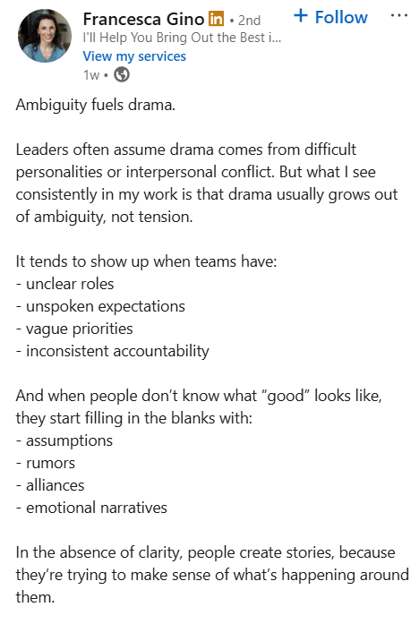
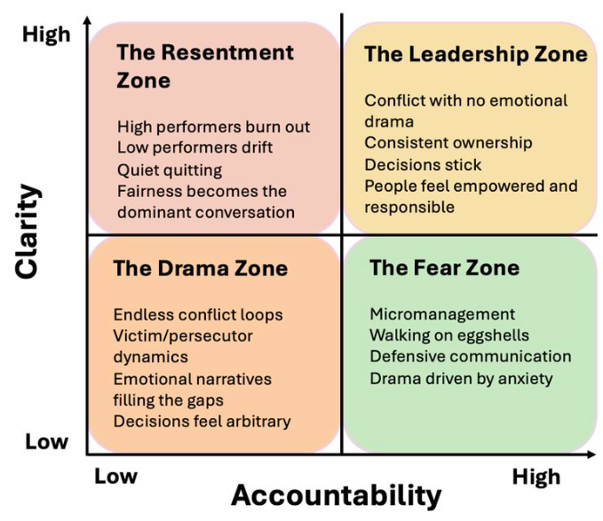

Slide 25
Resources
Harvard ED School Ladder of Influence Tips
  https://www.youtube.com/watch?v=V85ZbpiLvBw
Adam Grant “The Science of Productive Conflict”
  https://www.youtube.com/watch?v=XYKPoK017EM
The Reflexive Loop:
  https://www.youtube.com/watch?v=GPo3TFplD9M
Danny Kahneman: Thinking Fast and Slow (book)
  https://www.youtube.com/watch?v=PirFrDVRBo4
4 Tips for Heated Conversations or Arguments | #culturedrop | Galen Emanuele - YouTube

