Slide 1


FinAidlandia
‘aid-splaining’ across campus…
it takes EVERYONE to stay in compliance!
OASFAA Conference 2026
Frankie Everett | OASFAA President-Elect
Director of Financial Aid | Rogue Community College

Slide 2
“NO!”landia
‘aid-splaining’ across campus…
it takes EVERYONE to stay in compliance!
OASFAA Conference 2026
Frankie Everett | OASFAA President-Elect
Director of Financial Aid | Rogue Community College

Slide 3
FEDlandia
‘aid-splaining’ across campus…
it takes EVERYONE to stay in compliance!
OASFAA Conference 2026
Frankie Everett | OASFAA President-Elect
Director of Financial Aid | Rogue Community College

Slide 4
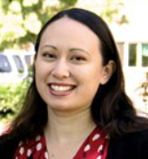
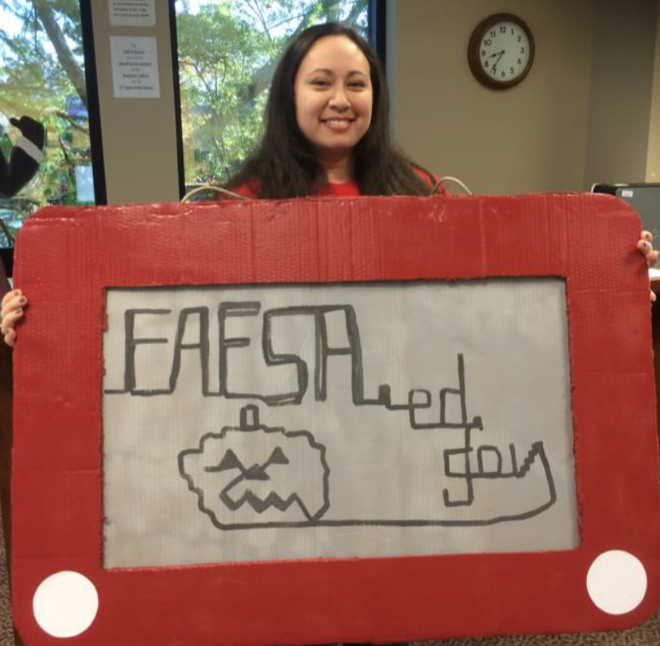
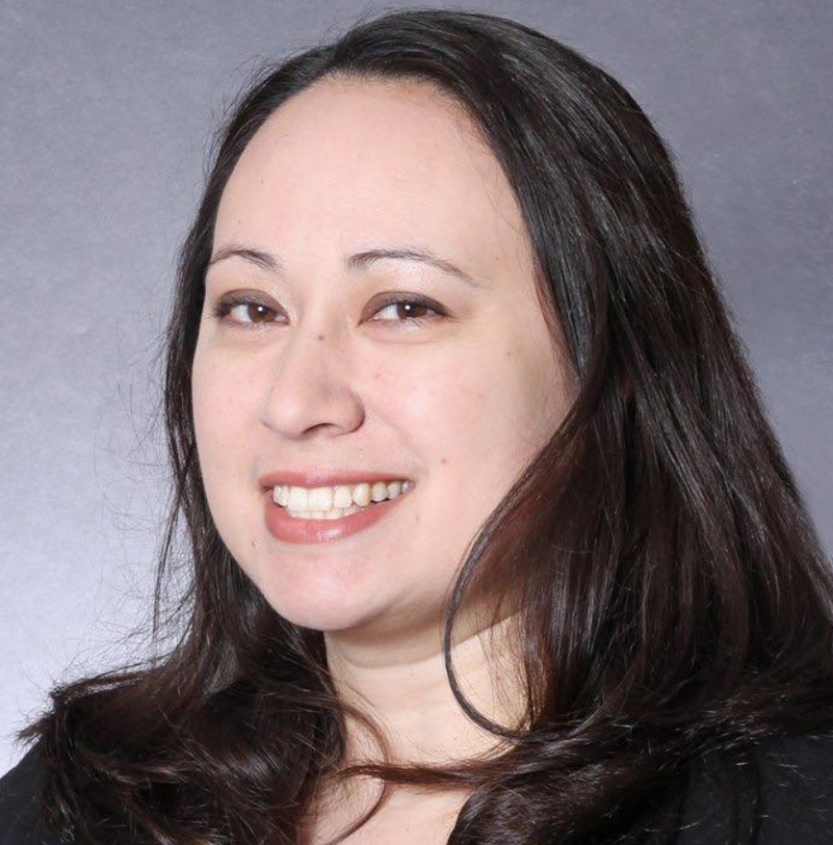
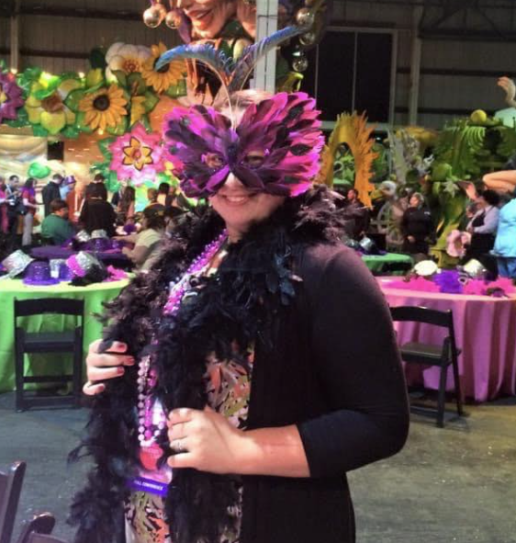
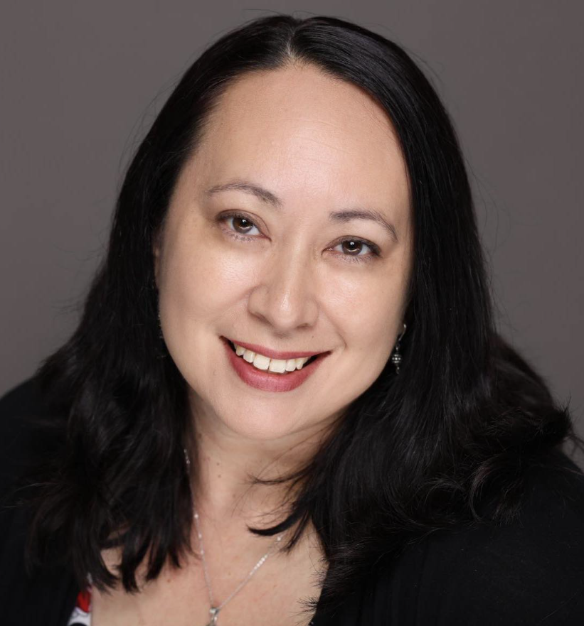

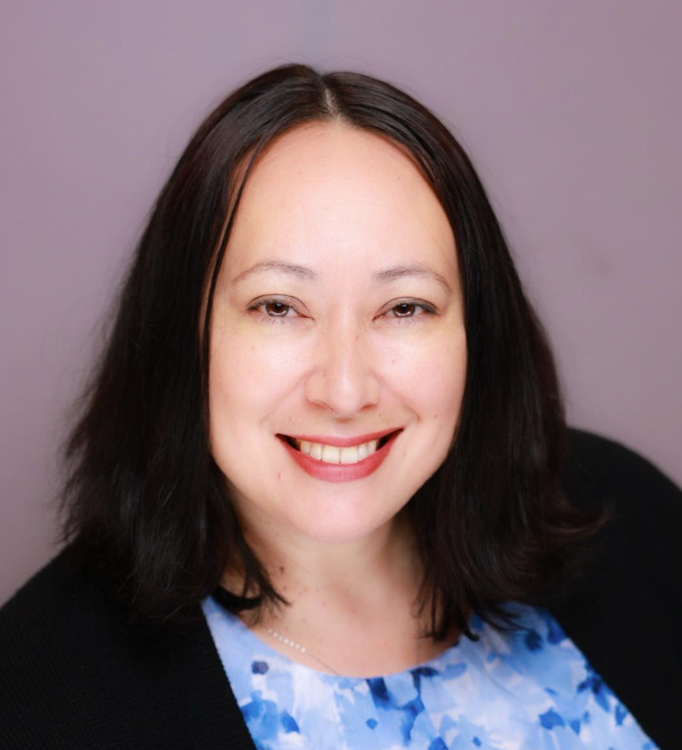
About Me
22 years in Financial Aid
9 yrs–private, 6 yrs–4 yr public, 7 yrs–2 yr public
OASFAA (& LASFAA) volunteer
Frankie Everett | OASFAA President-Elect
Director of Financial Aid | Rogue Community College

Slide 5

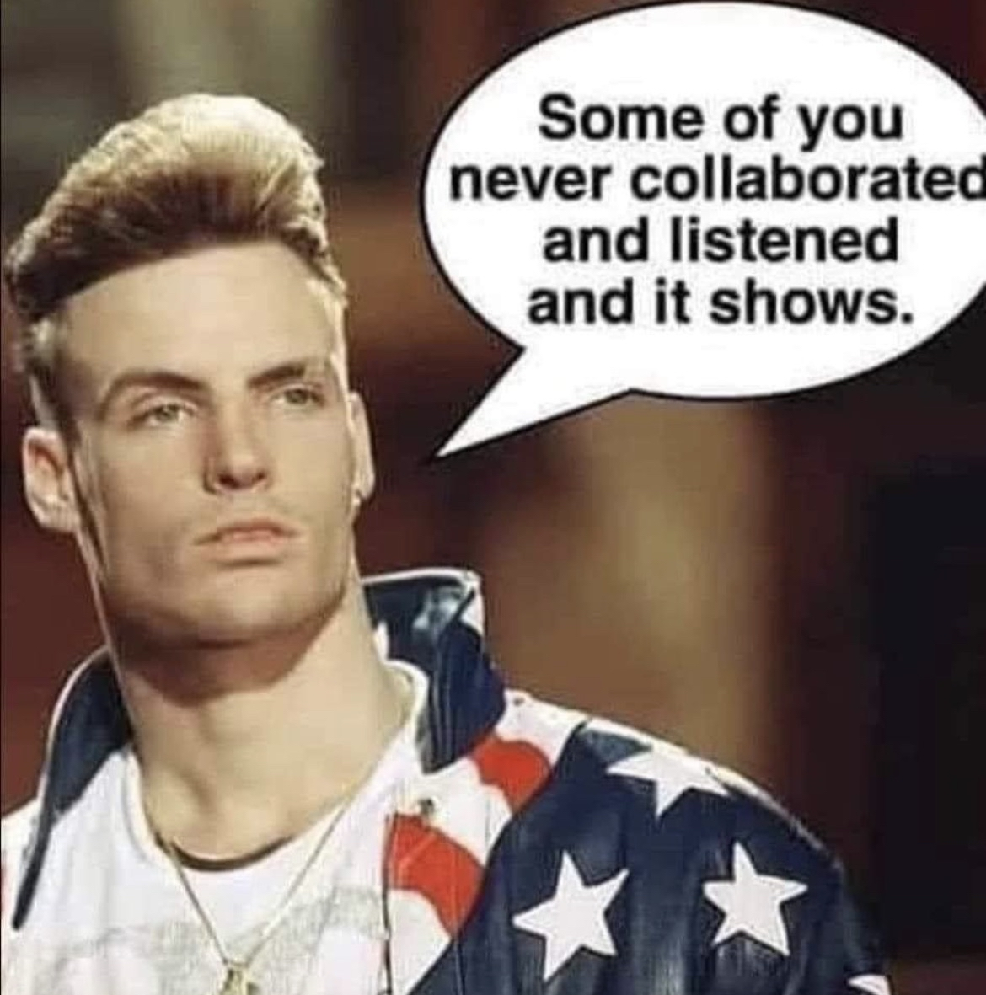
Today’s Agenda
WHAT your campus partners need to know?
WHO are the key players?
WHY are these things important?
HOW do we work together to stay in compliance?
Why YOU need to rub shoulders with folks across campus

Slide 6
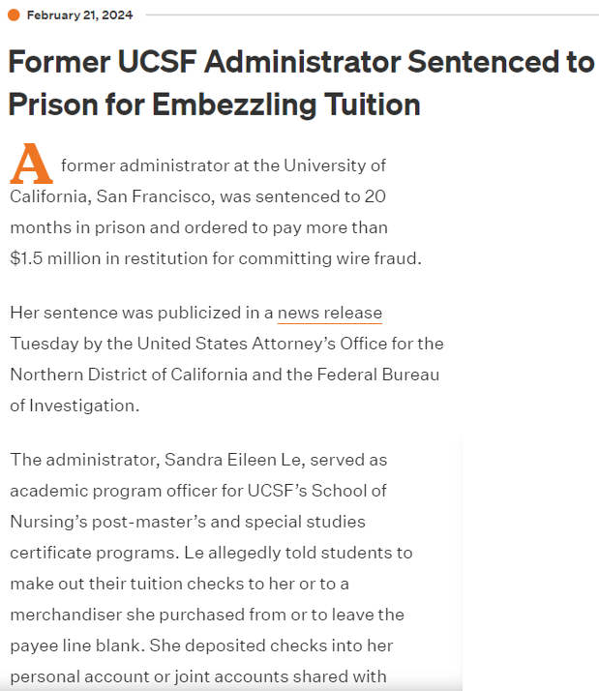
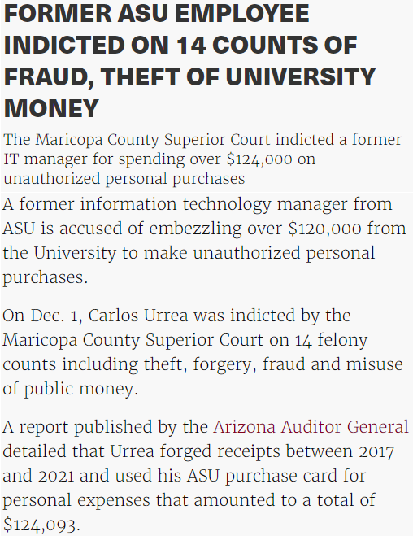
Why do we have compliance rules?

Slide 7
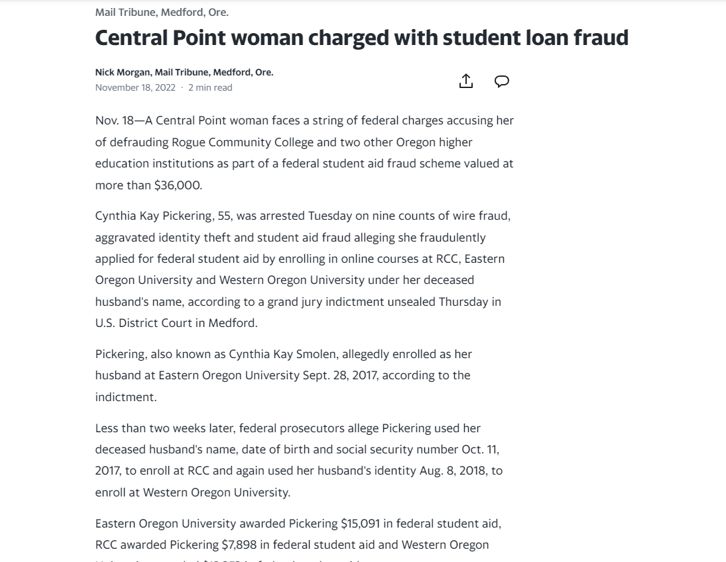
Why do we have compliance rules?

Slide 8
Why is this important?
Compliance
Federal deadlines & timelines
Internal Controls
Separation of duties, fraud prevention, consistent application of institutional policies & procedures
Administrative Capability
Accurate disbursements, refunds, repayments, grades, last date of attendance (LDAs)

Slide 9
The Key Players
Report to NSLDS
Drawdown/Return Money to G6
Credit balance to the student
Registration
Reports fees and charges
Student Accounts
Unlocks ability to register
Determine enrollment level
Authorizes Aid Initiates disbursement
Revenue goes to
Accounting Dept
Admissions
Tells FA what kind of student has been admitted
Financial Aid
Report Originations Payments to COD
FAFSAs

Slide 10
But wait… there’s more…
Report to NSLDS
Drawdown/Return money to the G6
Credit balance to the student
Registration
Reports fees and charges
Student Accounts
Unlocks ability to register
Determine Enrollment Level
Authorizes Aid Initiates disbursement
Revenue goes to
Accounting Dept
Admissions
Tells FA what kind of student has been admitted
Financial Aid
Report Originations Payments to COD
Reports new programs
Reports grades, LDA, & attendance
Curriculum
FAFSAs
Instruction

Slide 11
Who do your FAAs interact with? Where do you fit?
Executive Initiatives
Report to NSLDS
Drawdown/Return Money to the G6
Credit Balance to the Student
Public Safety
Reports fees and charges
Student Accounts
Revenue goes to
Accounting Dept
Registration
Title IX
Authorizes Aid Initiates disbursement
Receives money
Unlocks ability to register
Determine Enrollment Level
Dept.
Of
Education
Internal / External Auditing
Report payments
Oregon State
Admissions
Tells FA what kind of student has been admitted
Financial Aid
Report Originations Payments to COD
Reports new programs
Reports grades, LDA, & attendance
Internal Funding
Curriculum
External
Scholarships
Strategic Enrollment
Instruction
Athletics
Foundation
FAFSAs
?
?
?
?

Slide 12
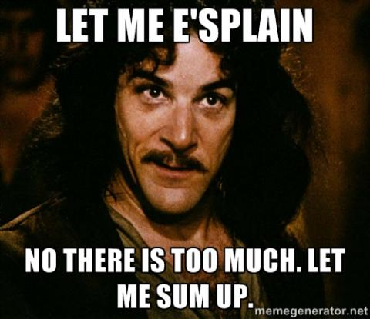
Find your opportunities for Financial Literacy

Slide 13
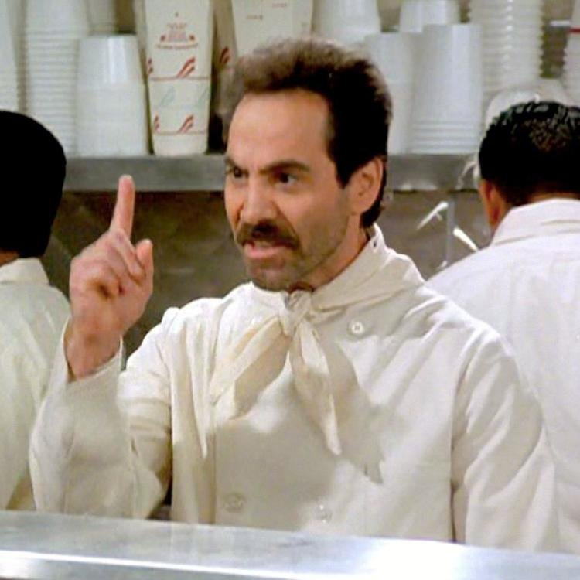
The Big One: Attendance
Did they start attending?
Did they actively participate?
Did they stop attending?
Did they withdraw?
Notes:
If you report grades at the very last second, don’t check your email while on break, and your information is inaccurate, we may miss our reporting deadline to stay in compliance.
Ex: a student was reported as w/d before the class was added! Eek!

Slide 14
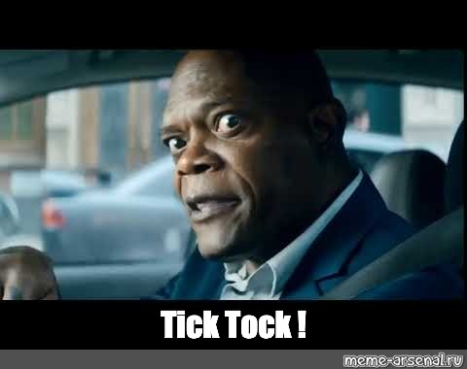
The Other Big One: Deadlines
45-day window to process R2T4
Once “we” learn the student withdrew, “we” have 45 days to return money.
What scenarios affect our ability to report on time?
Inaccurate LDA
No response from instructor during break
Notes:
If you report grades at the very last second, don’t check your email while on break, and your information is inaccurate, we may miss our reporting deadline to stay in compliance.
Ex: a student was reported as w/d before the class was added! Eek!

Slide 15
Did you know?
What is considered “active participation?”
Taking an exam
Meeting with an advisor
Participating in a study group
Submitting an academic assignment
Logging into LMS (e.g. Moodle, Bb)
Opening the syllabus on LMS

Slide 16
Did you know?
What is considered “active participation?”
Taking an exam
Meeting with an advisor
Participating in a study group
Submitting an academic assignment
Logging into LMS (e.g. Moodle, Bb)
Opening the syllabus on LMS

Slide 17
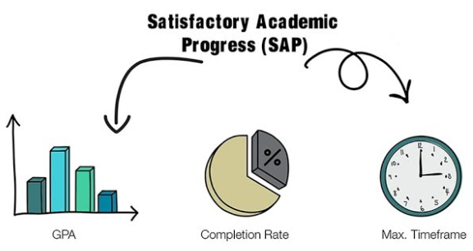
Satisfactory Academic Progress
Misalignment between:
Financial Aid SAP
Academic Standing
What’s best for the student
Other advice

Slide 18
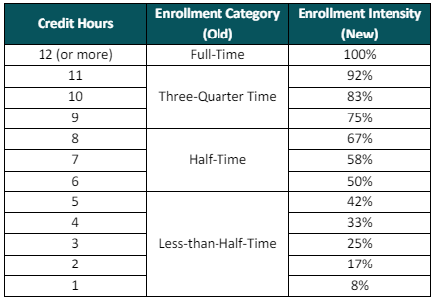
Pell Intensity
Pell changed for the first time in 2024-2025
Enrollment Level -> Intensity
Loan intensity is coming too!
How will this affect your students?

Slide 19
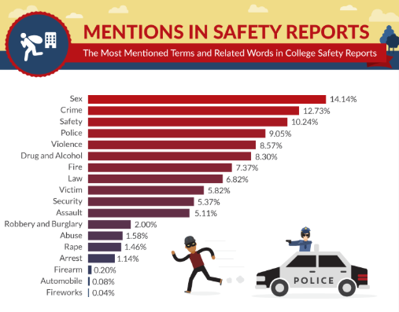
Consumer Information
FSA Handbook Vol. 2 Ch. 6
Policies on disbursements
Verification requirements
Loan info
Crime statistics
Cost of attendance
Any place we mention tuition we must include COA
Notes:
Whatever our policy is, we must follow it, or we can be dinged in an audit. (e.g. can’t make exceptions)
New for 24/25, any place we mention tuition costs for a program, we must also link to the COA

Slide 20

New Academic Programs
FSA Handbook Vol. 2 Ch. 2
Must meet certain requirements to be aid-eligible
Include Financial Aid & Registrar if you are looking to add any new programs
Notes:
Requirements for min length/credits, credits going toward AA/AS.
Beneficial to include Dani Crouch and me in the initial discussions to make sure it’s setup correctly.

Slide 21
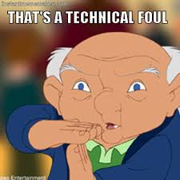
GE/FVT Reporting
FSA Handbook – Vol. 1 Ch. 1
Types of data captured:
Graduation rates
Average debt
Debt-to-earnings ratio
Programs that do not show success will be ineligible for federal financial aid

Slide 22
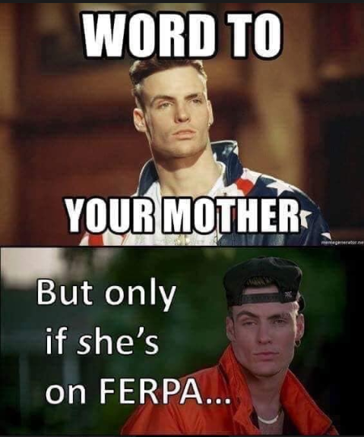
FERPA
Family Educational Rights & Privacy Act of 1974, as amended
The college receives federal funds in the form of federal financial aid (grant, loans, FWS)

Slide 23
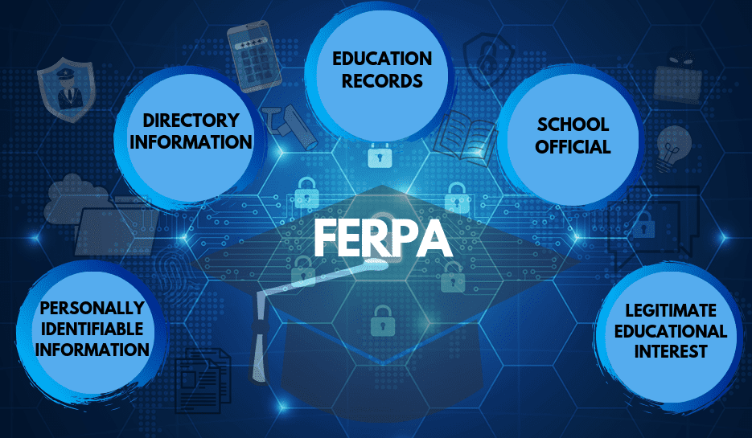
What is an Educational Record?
Any record directly related to a student and maintained by the college
Educational records may be in any medium, including handwriting, print, computer, database, LMS, email
FERPA protects the educational record of any student who has ever enrolled at the college

Slide 24
Did you know?
Which of the following is an educational record?
Email about a student from an advisor to an instructor
A student’s schedule displayed on a computer screen
A class list
A student’s grades
The quarterly schedule of classes
The Beatles’ White Album
A student’s phone number which he has written down and handed to a classmate

Slide 25
Did you know?
Which of the following is an educational record?
Email about a student from an advisor to an instructor
A student’s schedule displayed on a computer screen
A class roster
A student’s grades
The quarterly schedule of classes
The Beatles’ White Album
A student’s phone number which he has written down and handed to a classmate

Slide 26
Did you know?
Who is considered a “school official?”
A computer lab student employee
A member of the landscaping crew
The spouse of a student
A college accountant
The broista at the Dutch Bros by campus
The college president
A faculty member

Slide 27
Did you know?
Who is considered a “school official?”
A computer lab student employee
A member of the landscaping crew
The spouse of a student
A college accountant
The broista at the Dutch Bros by campus
The college president
A faculty member

Slide 28

Why is this important?
Gives student the right to inspect their records
Be careful what you say!
Legitimate Educational Interest
“Need-To-Know” basis
Confirming student identity

Slide 29
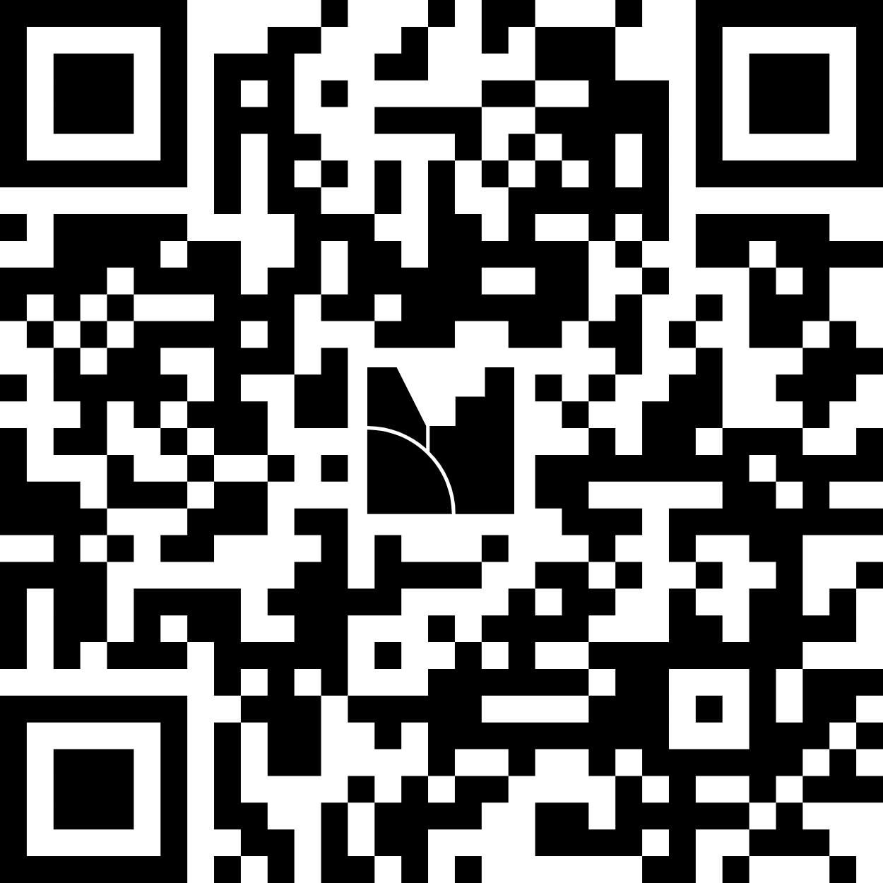

Mentimeter – WWYD?
Scan this QR code
Answers you provide are anonymous

Slide 30

Questions/Comments?
Please provide your feedback separate from conference evaluations.
Thank you!
Frankie Everett | OASFAA President-Elect
Director of Financial Aid | Rogue Community College

Slide 31

What committees do you serve on at your campus?
Scholarship committees?
Appeal committees?
Academic program committees?
Athletics?
What else?
All FAAs should be involved in
Financial Literacy efforts across campus!

Slide 32
Helpful Talking Point “Why’s”
Why are accurate class rosters important?
Why are accurate LDAs important?
Why is timely withdrawal important?
Why are accurate grades important?
What other why’s are there?

