Slide 1

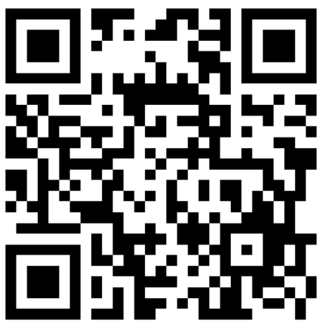

OASFAA CONFERENCE 2026
FINDING YOUR COMMUNICATION TREASURE WITH THE
DISC
ASSESSMENT
Notes:
Did everyone complete the FREE assessment ahead of time? (10 min)
Download free assessment – most info on pages 1-2

Slide 2

Content
01
What is DiSC?
02
What DiSC is not?
03
DiSC Details
04
Activity
05
Discussion
06
Wrap up

Slide 3



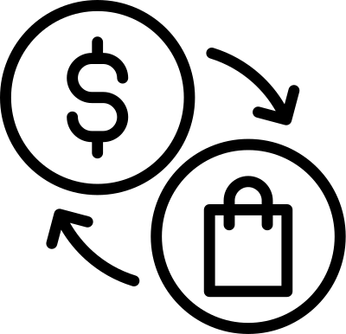

What is DiSC Assessment?
01
An indicator of behavioral tendencies
A tool to help us value and understand others
02
03
A tool to help us understand ourselves
A tool to help improve communication
04
Notes:
Brief History – page 4
Dr William Marston – Harvard psychologist in 1920s
Based on normal, healthy psychology
Behavioral styles
Two drivers: Motor/pace (horizontal) and Compass/priority (vertical)
- closer to outside = more defined/prominent

Slide 4
What the DiSC Assessment is not?
01
A test - there is no right and wrong
02
A Personality Text
03
A Box - not intended to be a labeling system
An Identity - this does not define you.
04

Slide 5

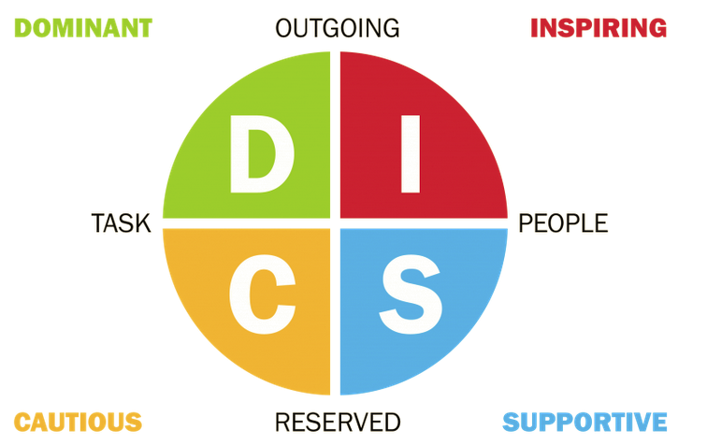
Outgoing, driven, confident, tend toward leadership roles, results driven
Charismatic, outgoing, engaging, provides new perspectives, very comfortable in the spotlight
Detailed, planner, analytical, love information, comfortable handling detailed tasks
Stable, patient, loyal, friendly, fosters trust and a team environment, good listeners
https://discpersonalitytesting.com/blog/what-is-the-disc-model/
Notes:
Page 8
Dominance – results driven, direct, assertive
Inspiring/Influence – enthusiastic, social, persuasive
Supportive/Steadiness – Supportive, reliable, calm
Cautious/Conscientiousness – Analytical, detail-oriented, precise
*most people display some of all the styles
Questions:
- Do you think your DiSC accurately reflects your behavioral/communication style?
- What surprised you about your style?
- What some strengths and challenges to your type?

Slide 6






COMMUNICATION STRATEGIES
Be Direct
Be brief and organized
Give them the “big picture”
Ask “what” not “how”
Refer to results
Don’t say “can’t”
Create space for ideas
Focus on social relationships
Support and respect others
Put details in writing
Don’t isolate them
Take time to build relationships
Appeal to the greater good
Be candid, open and trustworthy
Don’t over exaggerate
Don’t be domineering
Be organized and prepared
Support with facts
Appeal to head vs. heart
Give them a timeline
Don’t demand an immediate decision
Don’t minimize their high standards
Notes:
• Tips for interacting with each style:
- D: Be direct and focus on results.
- I: Be friendly and engage in open conversation.
- S: Be supportive and provide assurance.
- C: Be precise and provide detailed information.
• Example scenarios in financial aid.

Slide 7







ACTIVITY
Dominant
Inspiring
Influencer
Supportive
Steady
Cautious
Conscientious
Notes:
Have everyone move to a corner of the room based on their DiSC letter (groups)
Reflection questions – 15-20 min: (Come back as a group to discuss)

Slide 8
Activity Reflection Questions
01
What are some assumptions others may make of your style?
What are some assumptions you make of other style?
02
03
What is a challenge you have had due to not understanding someone’s style?
What can you do differently to meet someone’s style?
04
05
How does your style help you in your role as an FAA?
Notes:
Reflection questions – 3-5 min/question: (Come back as a group to discuss)
- What are some assumptions others may make of your style?
- What are some assumptions you may make of other styles?
- What challenges/obstacles have you come across due to not understanding their type/style? Example?
- What could you do differently to meet someone else’s style?
- What would you like others to know about you?
- How does your style help you in your role as an FAA?

Slide 9



THANK YOU
Breana Sylwester
Director of Financial Aid and Veteran Benefits
Central Oregon Community College
541.383.7578
bsylwester@cocc.edu

