Slide 1

Implementing Banner Course Program of Study (CPOS)
Lessons from Linn-Benton Community College’s “Degree-Approved Courses” (DAC) Project
Karen Ash, Director
Leslie Lloyd, Associate Director

Slide 2
The Why – Regulatory Compliance
Title IV Requirement: Federal aid can only be awarded for courses that count toward a student’s degree or certificate
To be eligible for Title IV funds, a student must be a regular student as defined in 34 CFR 600.2 of the Institutional Eligibility regulations. A regular student is defined as: “ A person who is enrolled or accepted for enrollment at an institution for the purpose of obtaining a degree, certificate, or other recognized educational credential offered by that institution.” Therefore, the school cannot award federal Title IV aid for credit hours/course work that will not count towards the completion of that student’s degree program requirements (NASFAA Ask Regs)

Slide 3
The Other Why
While not a new requirement, modernized systems (Banner/Degree Works) now allow for automated enforcement
Goal: Ensure institutional compliance and protect federal funding while helping students graduate faster by staying on track
CPOS designed to help students finish their degree faster by focusing on coursework directly related to their program of study
Students who complete their program in a timely manner can graduate with reduced costs and less student debt
Guided Pathway friendly

Slide 4
Implementation Story at LBCC
Cohesion 2023 was an eye opener
  Acquired consultant help early 2024 with the goal to launch Summer 2024
It worked, but we weren’t ready
  Decision to Delay until Summer 2025
  CPOS Steering Committee
  Discussions Across Campus

Slide 5
Implementation Story at LBCC
Not possible without full campus support and acknowledgment
  Not just a financial aid project
    Registrar/Enrollment Services
    Business Office
    Programers/Analysts/Systems Manager
    Bookstore
    Academic Dean's/Advisors/Curriculum Coordinators
    Communications/Media
Not something you just ask IT to turn on
TALK TO ADVISORS
  First line support for students
  Some of them know the programs better than the faculty do

Slide 6
Technical Infrastructure
Core Systems: Banner (Student Information System) and Degree Works (Degree Audit).
The Audit, most important part of CPOS!
  Clean Diagnostics
  Up-to-Date DegreeWorks
  Identify Common Petitions/Exceptions/Substitutions
  Identify how many catalog years you support (outside of window, No CPoS)
Integration: How Banner "talks" to Degree Works to flag ineligible courses in real-time during registration.
Student Interface: Using the WebRunner Financial Aid Dashboard and Degree Works "What-If" audits.

Slide 7
Implementation Timeline & Strategy
Phased Rollout: Starting with pilot groups or specific aid years
2024-25 Academic Year
Fall Term ~ Testing and Development
Winter Term~ Turned on functionality with view only to staff
Spring Term ~ Added viewable to students with targeted communication
2025-26 Academic Year
Summer 2025 ~ Go Live!
Collaboration: A cross-functional effort between the Financial Aid Office, Registrar, Academic Advising, and IT
Testing: Rigorous auditing of "Degree Works" scribing to ensure program maps were accurate before "turning on" the CPOS flags

Slide 8
Just a few things to update:
Financial Aid:
R2T4 calculations (new reports)
TIV Authorization Questions
WebRunner ~ Financial Aid Dashboard
Business Office:
Fund code set-ups
  Only applies to federal aid NOT state aid, scholarship, institutional funding

Slide 9
What is DAC?
LBCC’s internal branding for CPOS is Degree-Approved Courses or DAC
Creation of the DAC Informational Page with FAQs and examples
Targeted messages for both faculty, staff, and advisor as well as students
Faculty and Advisor training during Fall In-Service to help support students

Slide 10
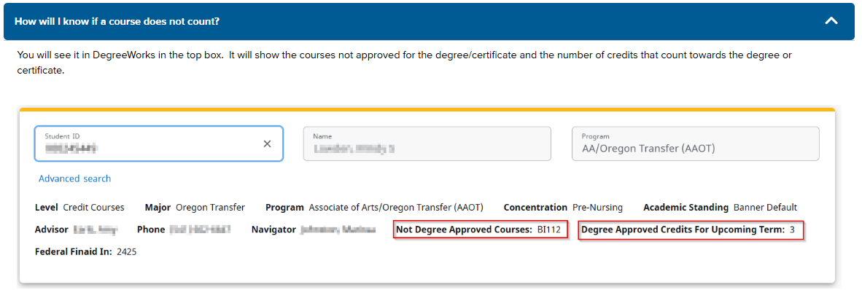
Student & Advisor
Advising for All: Advisors are trained to treat all students as if they are aid-recipients to ensure consistent graduation pathways
Messaging: Student and their academic advisor receives an email when enrolled in Non-approved course. Advisor receives report with all students enrolled in non-approved courses.

Slide 11
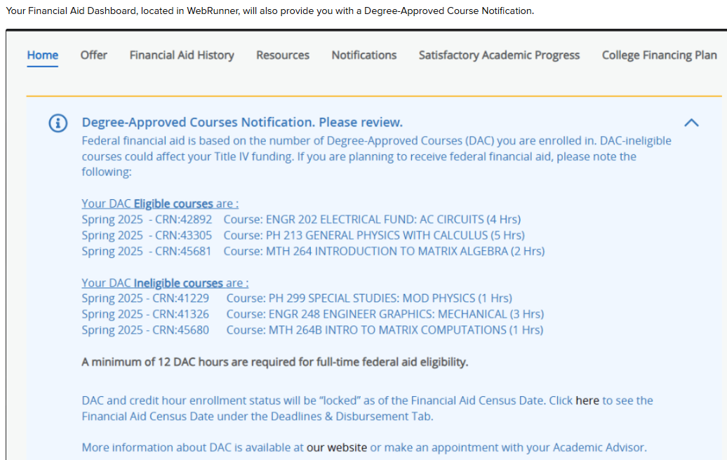
Financial Aid Dashboard
During registration period and the first week of the term, students Financial Aid Dashboard via WebRunner, displays their current term Degree-Approved Courses Notification:

Slide 12
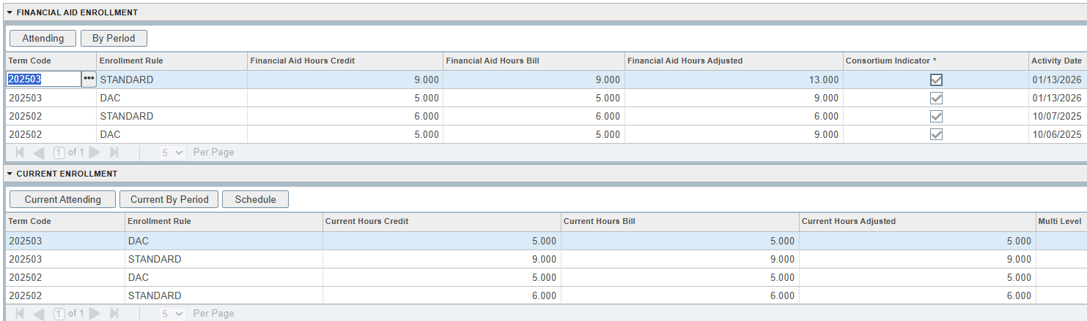
Banner display in ROAENRL
State aid is paid on STANDARD hours. Federal aid is paid on DAC hours.

Slide 13
Impact on Courses and Aid Eligibility
Summer 25
33 non-approved,25 students going below 12 credits prior to start of term
Census date, 13 students had aid impacted due to non-approved registrations
Fall 25
In July 107 students with impacted aid
One week prior to term statuing; 65 total students who will have their aid impacted by DAC
Census date, 43 students (less than 0.8% of our total student population and less than 2.5% or our aid receiving population) impacted by DAC
Winter 26
139 Non-Approved Registrations for DAC-Bearing students
80 Students with projected aid impact from non-approved DAC Registrations
  Early December, Winter evaluation not complete at this moment

Slide 14
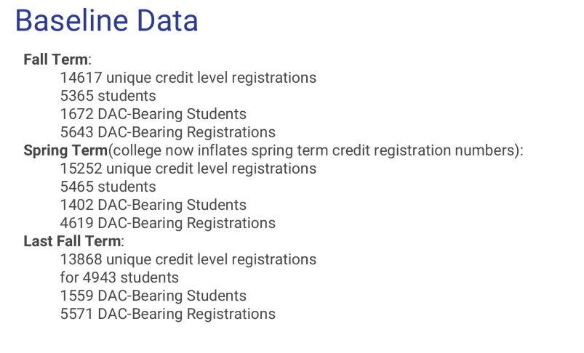
Summary Data

Slide 15
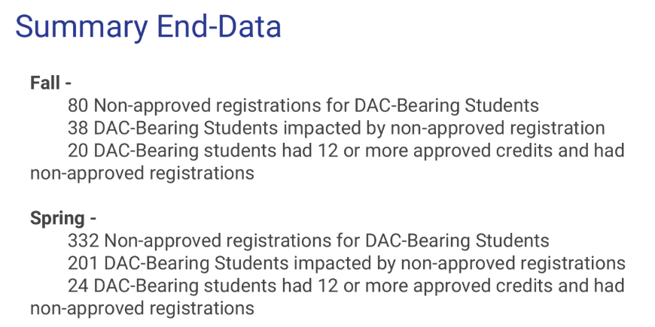

Slide 16
Key Takeaways…
Success:
Higher degree-completion focus; reduced "excess credits" for students
Lesson:
Technical accuracy in Degree Works is the foundation—if the audit is wrong, the aid is wrong
Understand if you need any custom processes before you go-live
What’s next:
Tracking SAP Appeals in regards to Max Time Frame
Will they decrease?
Should we remove the education plan?

Slide 17
References
Slide 2: NASFAA Ask Regs https://askregs.nasfaa.org/article/34393/can-title-iv-aid-pay-for-a-course-that-does-not-count-toward-the-student-s-degree-completion-requirements
Useful Links
  Degreeworks cpos one-stop-shop E-Community Post https://elluciansupport.service-now.com/customer_center?id=community_blog&sys_id=30371e3097ee6610ebc2bdcfe153afc1
  Tip-of-the-week repeated classes https://elluciansupport.service-now.com/customer_center?id=community_blog&sys_id=5cbe01cf8343da54546a7d447daad3f1
  2024-2025 FSA Handbook https://fsapartners.ed.gov/knowledge-center/fsa-handbook/2024-2025/vol1/ch1-school-determined-requirements
  CR for FREEZETYPE and DESCRIPTION change https://elluciansupport.service-now.com/customer_center?id=standard_ticket_customer_center&table=ellucian_product_enhancement&sys_id=4abd971997974d105154d004a253afdc&view=sp

Slide 18


